Slide 1
盒子精的 UX/UI/... 内训

Slide 2
It's not you. Bad doors are everywhere.

Slide 3
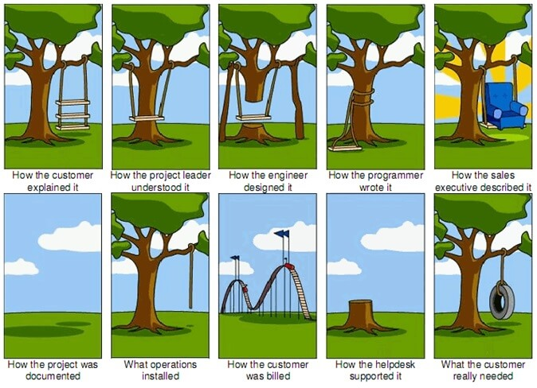

Slide 4
What is User Experience Design?
Usability

Slide 5
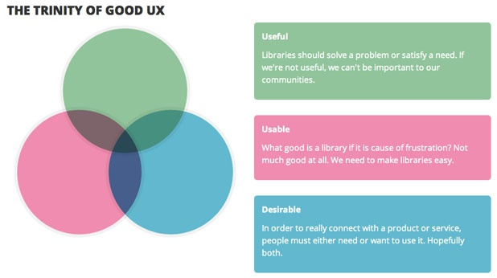

Slide 6
Usability Means …
Usability means that a person using a system finds it easy to understand and use.

Slide 7
Usability Means …
A usable system allows a person to focus on their tasks, and not on the system itself.

Slide 8
Usability Means …
A usable system most often does what a person expects.

Slide 9
Usability as a Measurement
Learnability
Efficiency
Memorability
Error Rate
Satisfaction

Slide 10
Learnability
Learnability - how easy is it for users to accomplish basic tasks the first time they encounter the design?

Slide 11
Efficiency
Efficiency - once users have learned the design, how quickly can they perform tasks?

Slide 12
Memorability
Memorability - when users return to the design after a period of not using it, how easily can they reestablish proficiency?

Slide 13
Error Rate
Error Rate - how many errors do users make, how severe are these errors, and how easily can they recover from the errors?

Slide 14
Satisfaction
Satisfaction - how pleasant is it to use the design?

Slide 15
What is User Experience Design?
The Full UX Stack

Slide 16
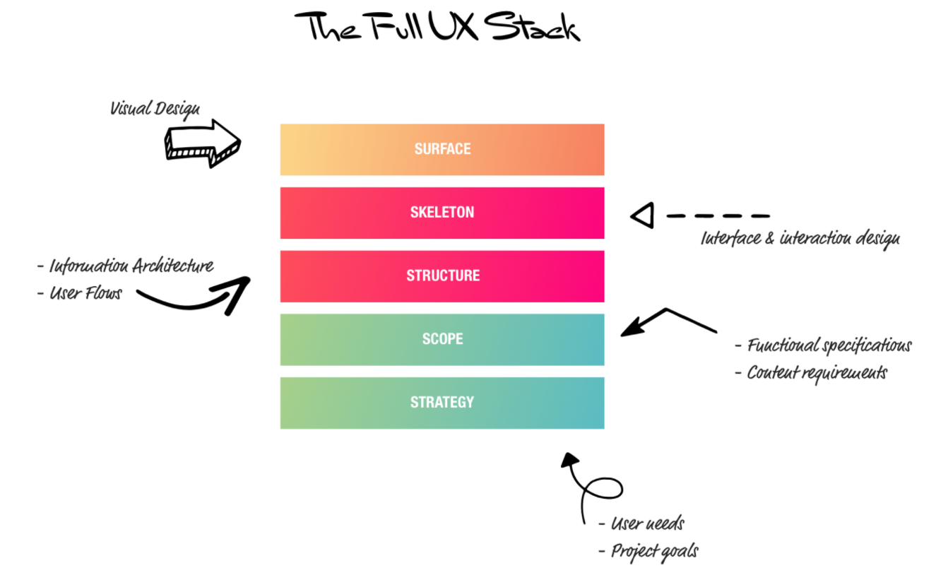

Slide 17
Strategy & Scope
Do users need the product you are making?
Do they want it enough that they will either pay for it or if it is free, spend time looking for it and learning to use it?
Are you missing a key feature they will need?
Are you spending time building features they will never use?

Slide 19
Structure & Skeleton
How should the content be organized so that users can easily find it?
Will users find your app easy to use? Where do they get confused or lost?
What content is needed and how should it be written to be most engaging?

Slide 21
Surface
What should the visual tone of the product be?
How do users feel when they see your product? Do they trust it?
It the product visually appealing and does it spark joy?
Is the visual design usable and accessible?

Slide 22
UX is a mindset that should be shared by the whole team.
In this way UX isn’t a single step in a process but a skill that must be applied at each stage.

Slide 23
What is Interaction Design?
3 HCI Laws

Slide 24
Miller’s Law
Most people can only hold approximately seven pieces of information in their short term memory at once.

Slide 25
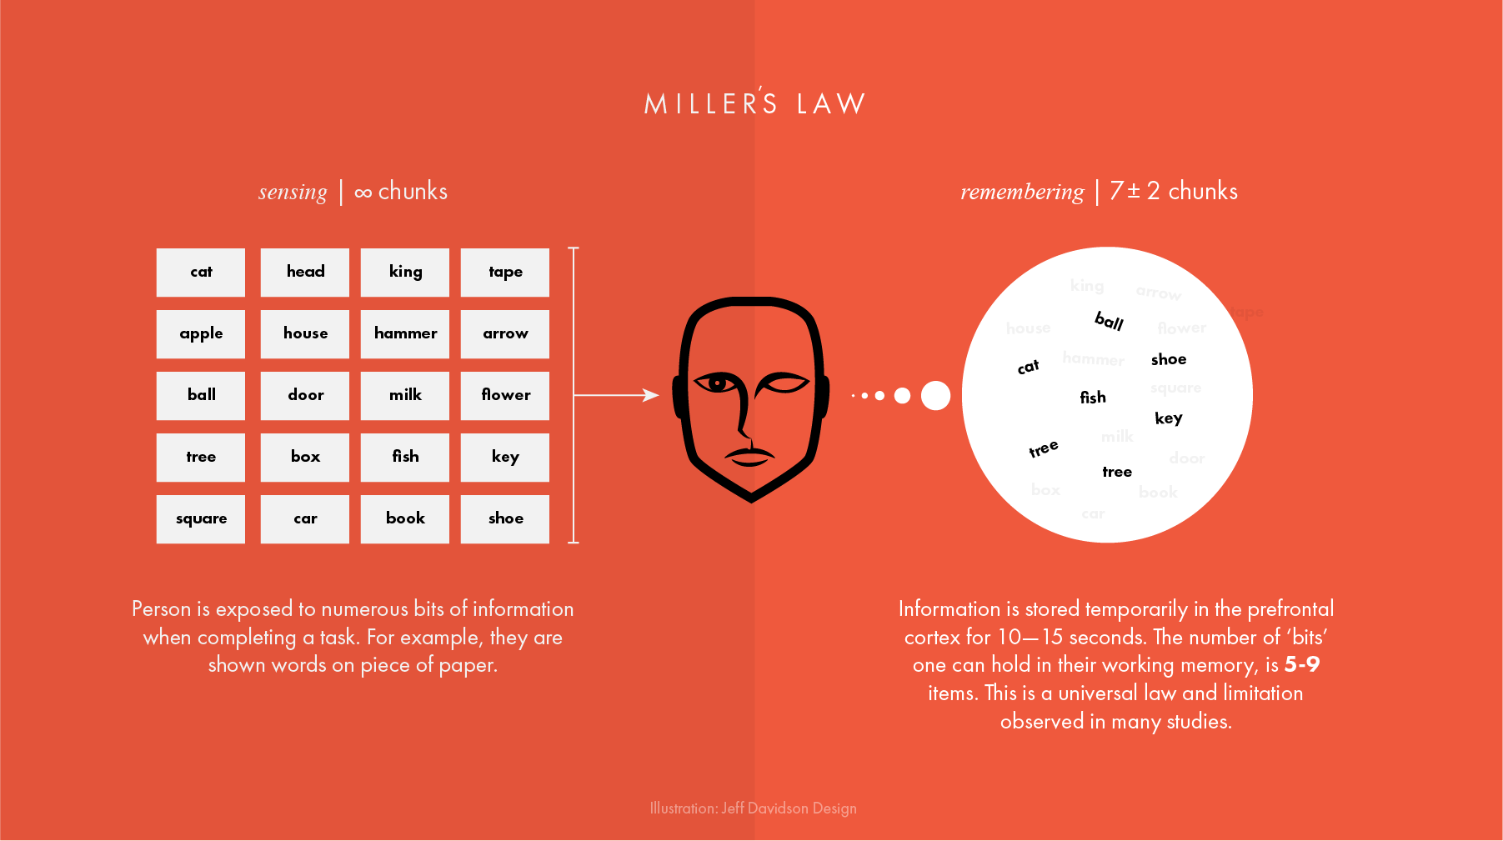

Slide 26
Miller’s Law
The ability of working memory to store short-term information can be increased by “chunking” data.
e.g. telephone number
menu or a selection list

Slide 27
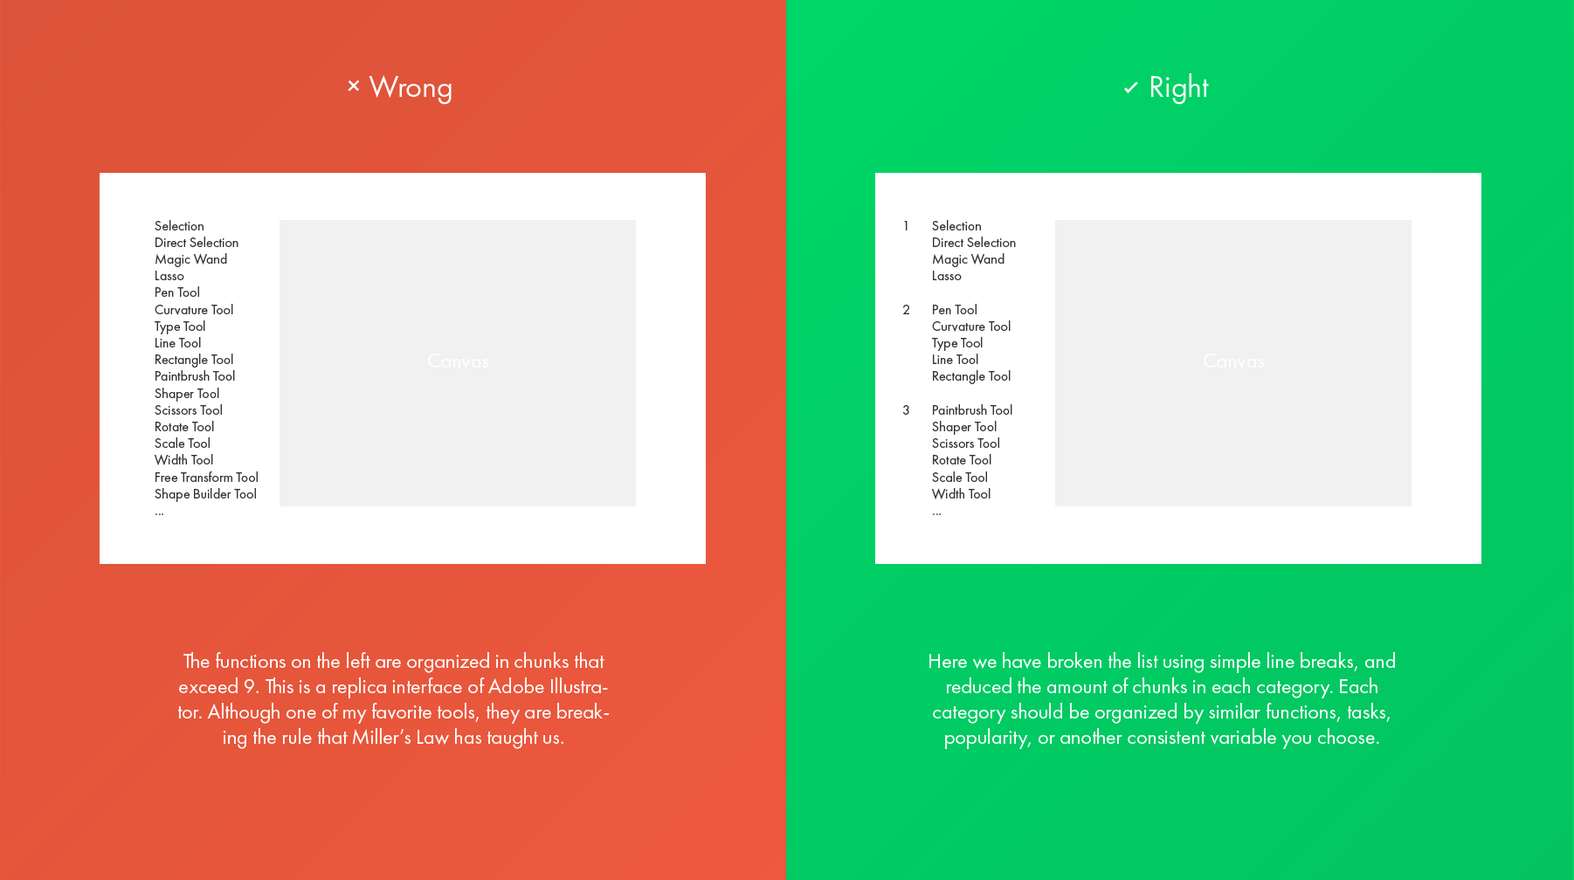

Slide 28
Fitts’ Law
It takes users longer to point to links and buttons on a screen if the objects are smaller in size or farther away from the home position.

Slide 29
“Fat Finger” Problem
For users to quickly and accurately select a touch target, its minimum size should be 1cm × 1cm.

Slide 30
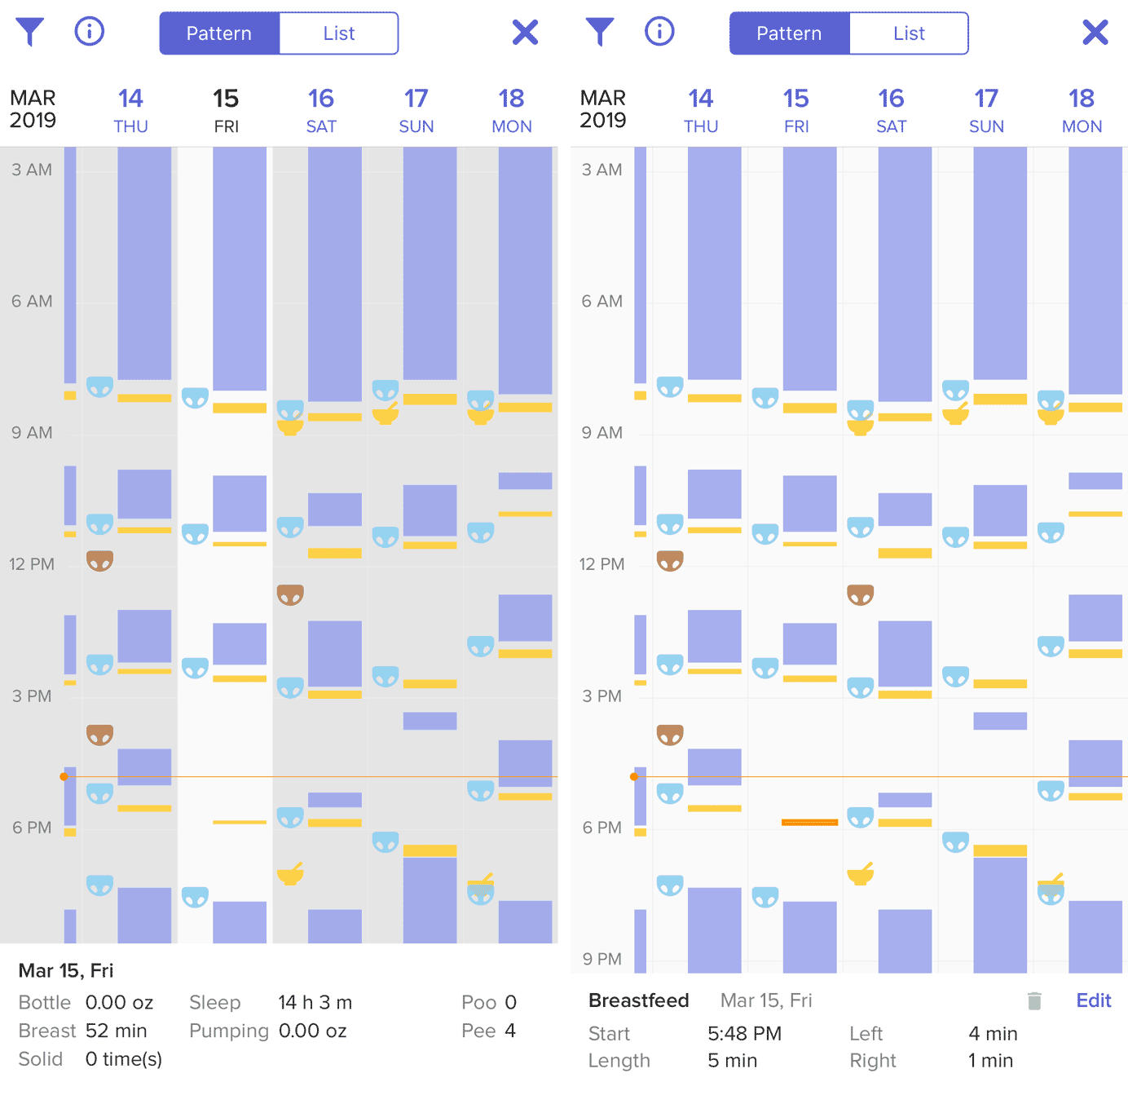
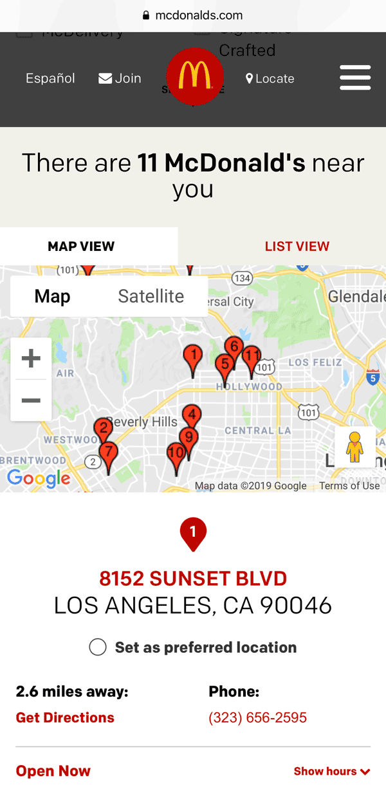

Slide 31
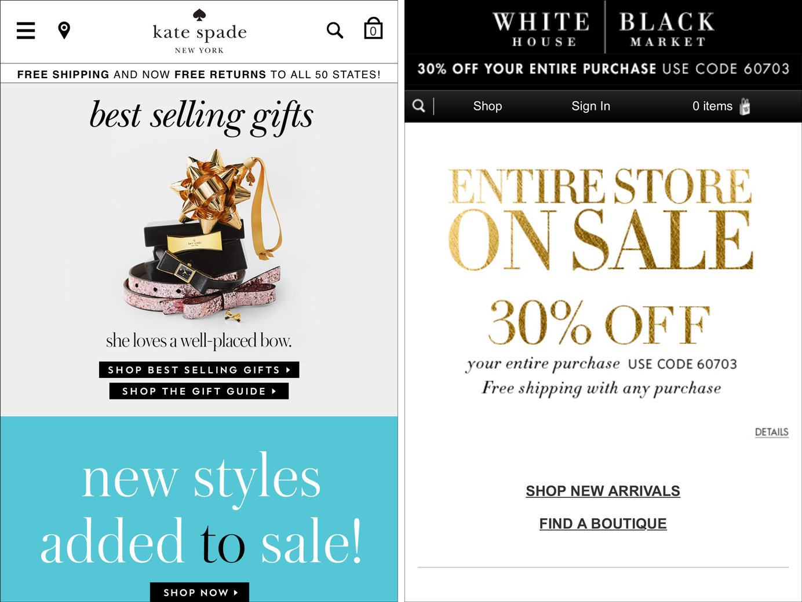

Slide 32
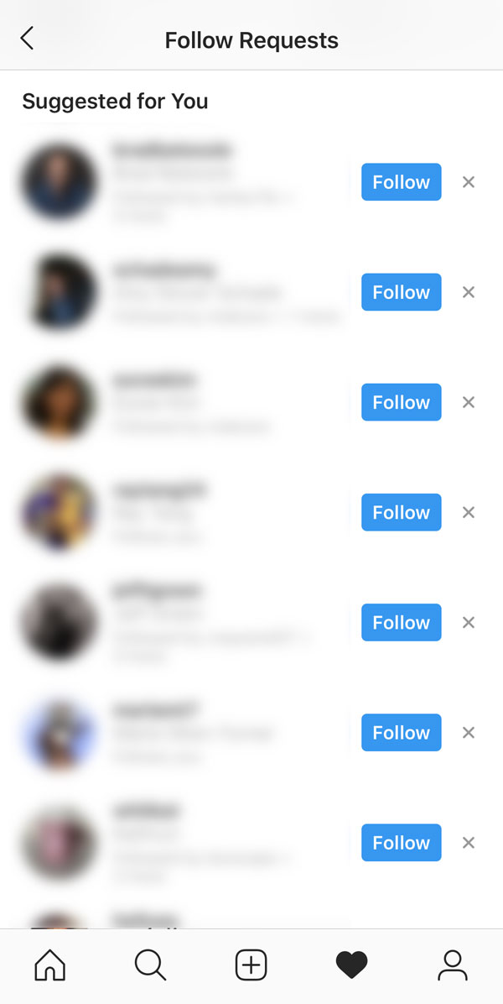

Slide 33
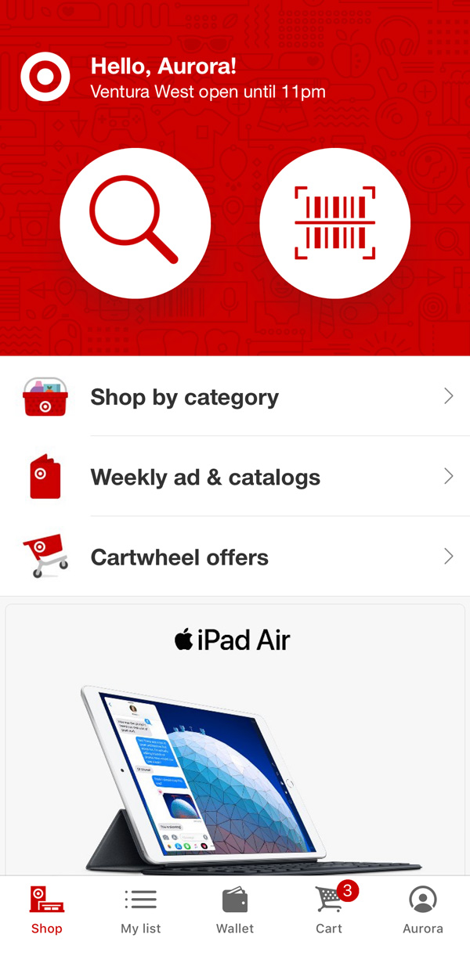
When Bigger Is Better
approximately 2cm × 2cm

Slide 34
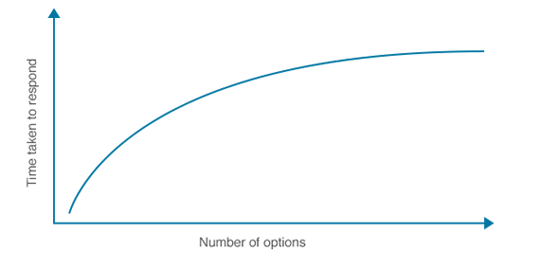
Hick-Hyman Law
It described the time it takes for a person to make a decision based on the number of choices available.

Slide 35
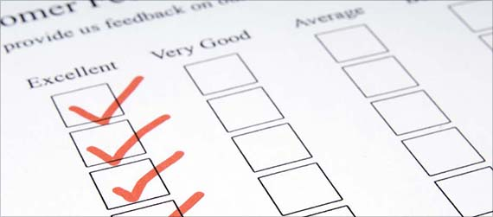
Hick-Hyman Law
People subdivide the total collection of choices into categories, eliminating about half of the remaining choices at each step

Slide 36
What is Interaction Design?
5 Dimensions

Slide 37
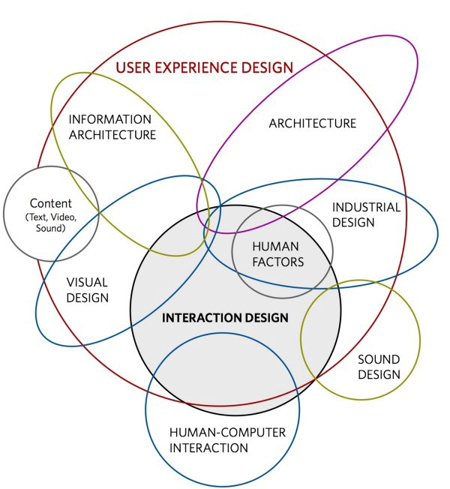

Slide 38
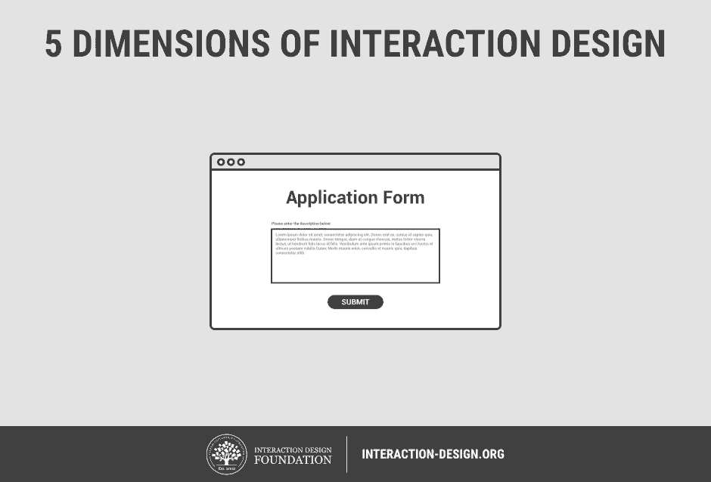

Slide 39
5 Dimensions of Interaction Design
Words
Visual representations
Physical objects or space
Time
Behavior

Slide 41
Words
The safe and recommended option is to drop all the tech vocabulary and focus on words that your users are already familiar with.
e.g. regex

Slide 43
Visual representations
Icons, shapes, backgrounds and etc. that we can see, register and understand in a split second.

Slide 44
Visual representations
The cool thing is that people already have many visual representations embedded in their long-term memory.

Slide 45
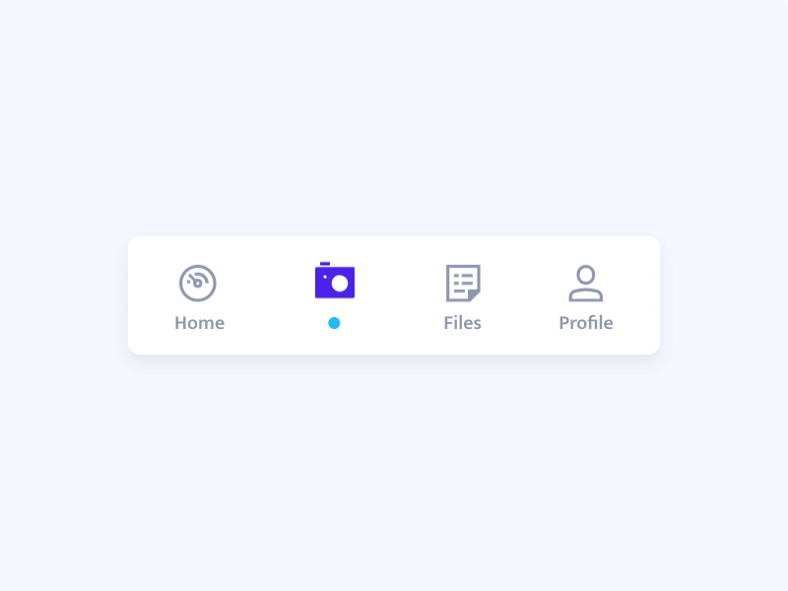

Slide 47
Physical objects or space
Actual hardware of any computer, the mouse, screen (mobile or computer), game controller or keypad.

Slide 49
Time
Sounds, vibrations and animations — all the other roads of communication you can take while the user interacts with your product.

Slide 51
Behavior
The form in which interaction design takes place, the flow with which any action unleashes a reaction.

Slide 52
What is Interaction Design?
Principles

Slide 53
Principles for Interaction Design
Discoverability
Consistency
Learnability
Readability

Slide 54
As the designer, you’re closely familiar with the product in all its glory.

Slide 55
As the designer, you’re closely familiar with the product in all its glory.
It can be difficult to imagine meeting that product for the first time, to try and use it while knowing nothing about how it works.

Slide 56
Discoverability
How to ensure your product has a good level of discoverability?
Create navigation routes
Make the most important buttons within reach
User testing
-- Create early prototype and iteratively test

Slide 57
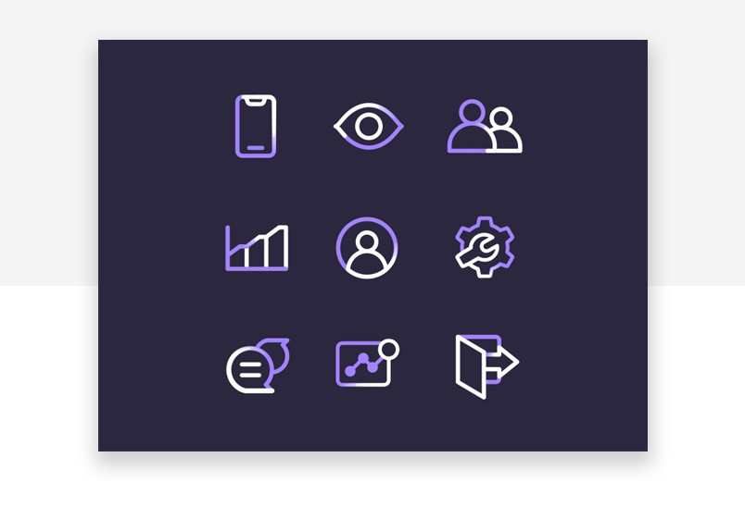
Consistency

Slide 58
Consistency
Users will make assumptions about your interface, and you need to make sure their assumptions are proven right the more they use the product.
Make sure that once you pick an icon for an interaction, all of the same interactions work with the same icon and in the same fashion!

Slide 59
Learnability
Initial learning curve
More challenging in mobile screen

Slide 60
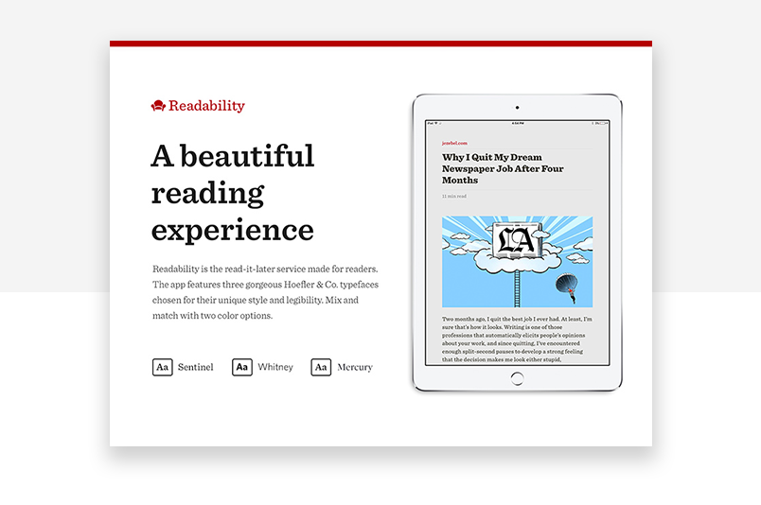
Readability

Slide 61
Readability
Allow every user to run their eyes through your page and understand what the general message is, without actually reading the content.
Consider:
How many lines each paragraph ought to have
Use of negative space
Proper line spacing

Slide 62
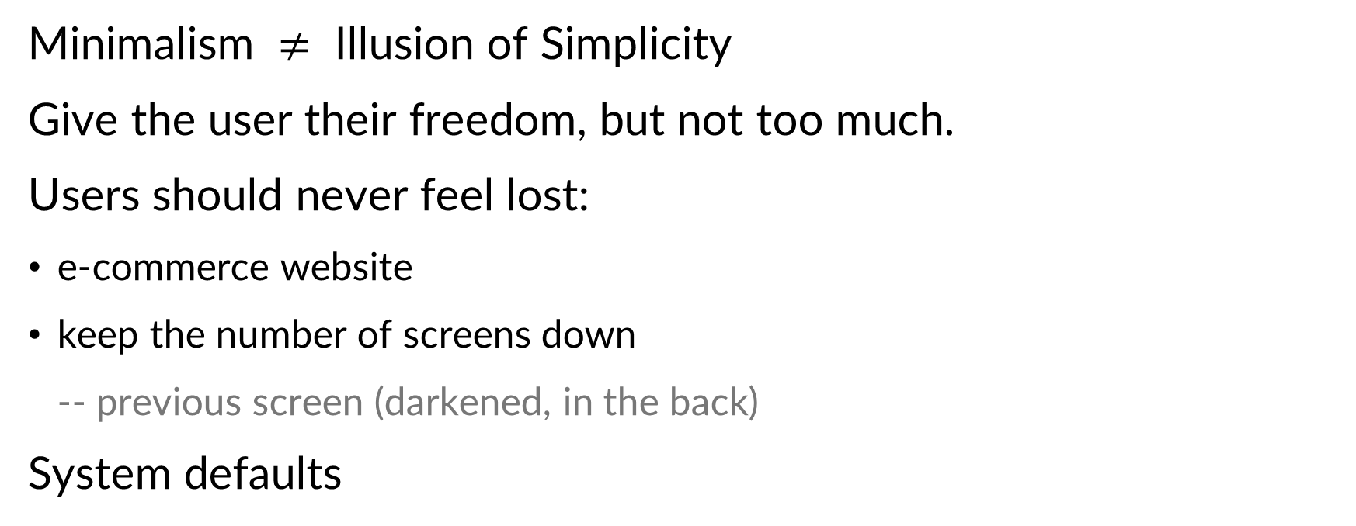
Minimalism $≠$ Illusion of Simplicity
Give the user their freedom, but not too much.
Users should never feel lost:
e-commerce website
keep the number of screens down
-- previous screen (darkened, in the back)
System defaults

Slide 63
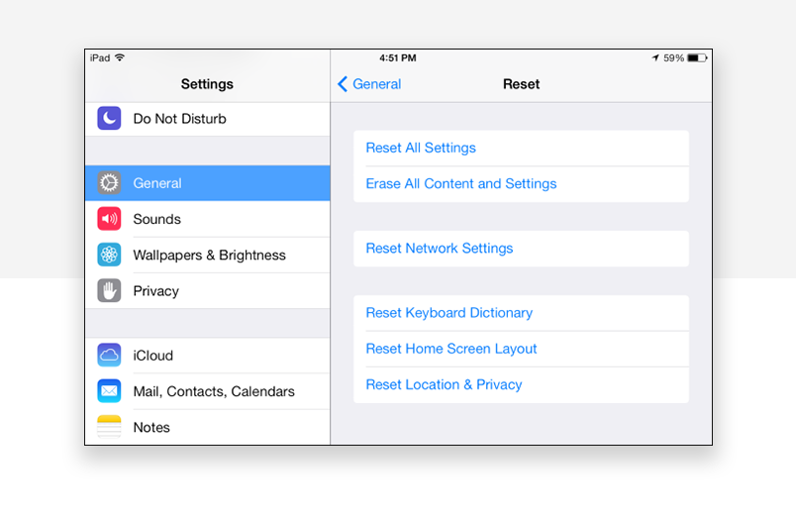
Have certain system default settings

Slide 64

Don’t keep users waiting

Slide 65
1–2 seconds: use an animated icon or other types of microinteraction to demonstrate the system is acting
Over 2 seconds: Just tell them an estimate of the waiting time.
Over 5 seconds: Use a progress bar. The thing about the progress bar is that it should be accurate, meaning that the task must be over when the progress bar reaches its completion — or risk having confused or disappointed users.
Over 10 seconds: Keep users informed of progress (with an animated bar or other indicator) and entertained.
Over 15 seconds: Keep users informed and entertained — but add a noticeable sound and visual aid so the user can leave your product and know when to come back once task is done.

Slide 66
Mobile & Multi-device Design
Mobile Design

Slide 67
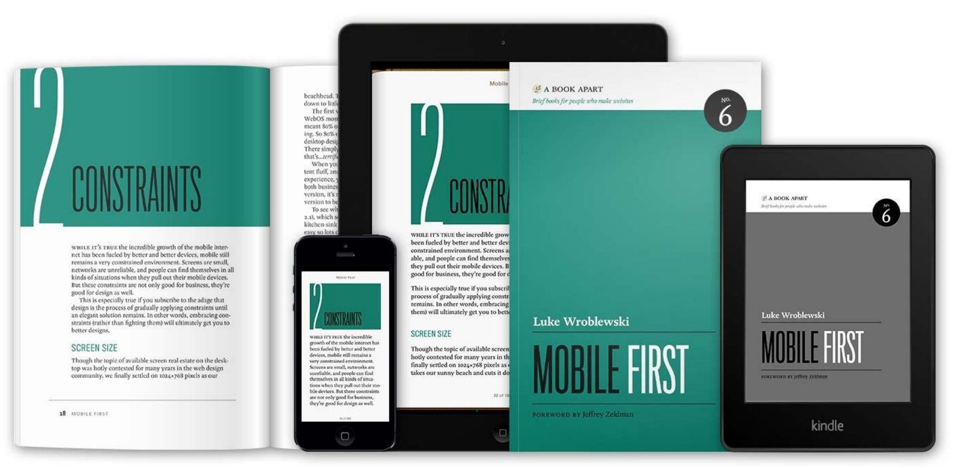

Slide 68
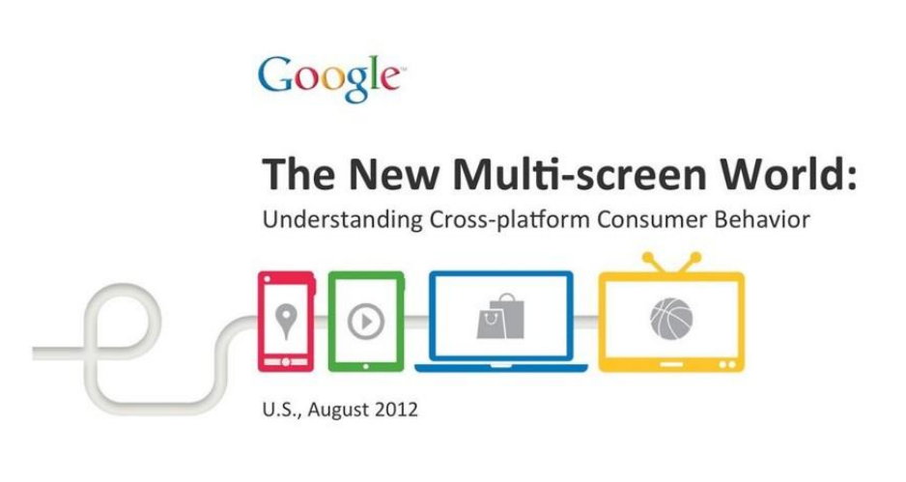

Slide 69
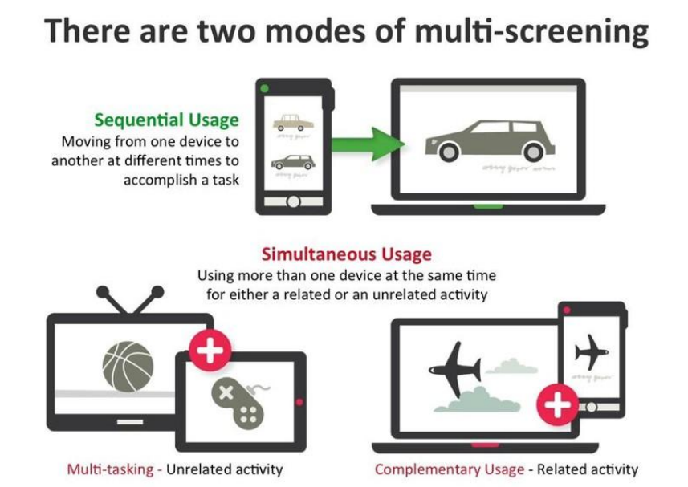

Slide 70
Google Mobile Design Principles
Home page and site navigation (1 of 5 categories)
Keep calls to action front and center
Keep menus short and sweet
Make it easy to get back to the home page
Don’t let promotions steal the show
developers.google.com/web/fundamentals/design-and-ux/principles

Slide 71
iOS Mobile Design Principles
Aesthetic Integrity
Consistency
Direct Manipulation
Feedback
Metaphors
User Control
developer.apple.com/design/human-interface-guidelines/ios/overview/themes

Slide 72
Mobile & Multi-device Design
Touch Interaction Design

Slide 73
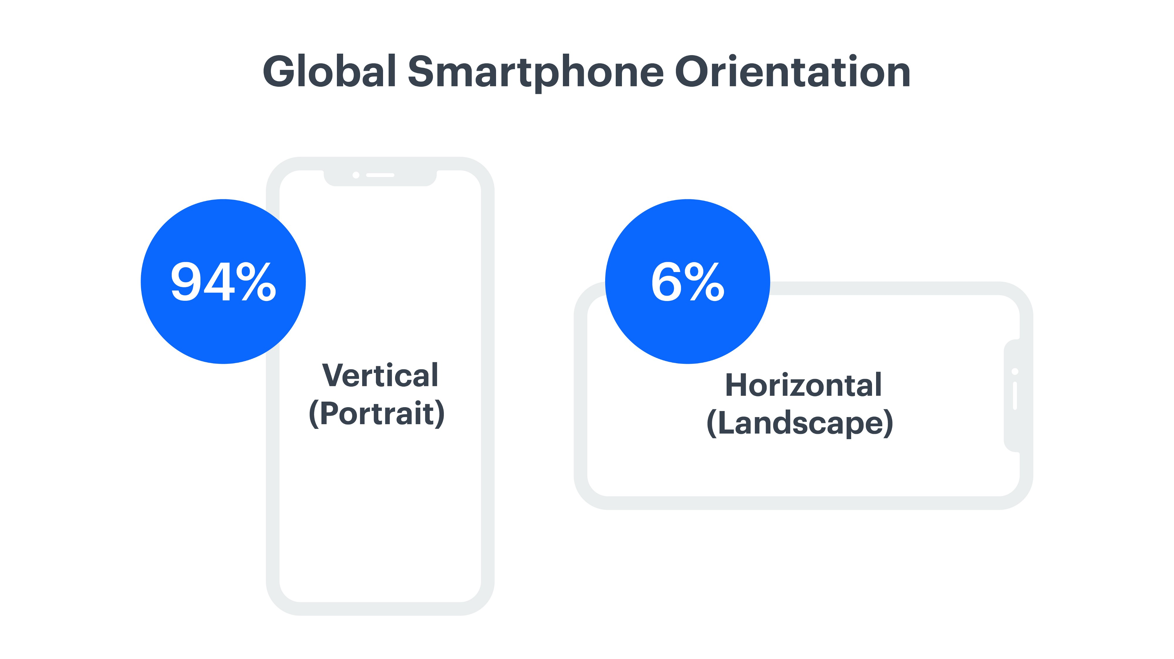

Slide 74
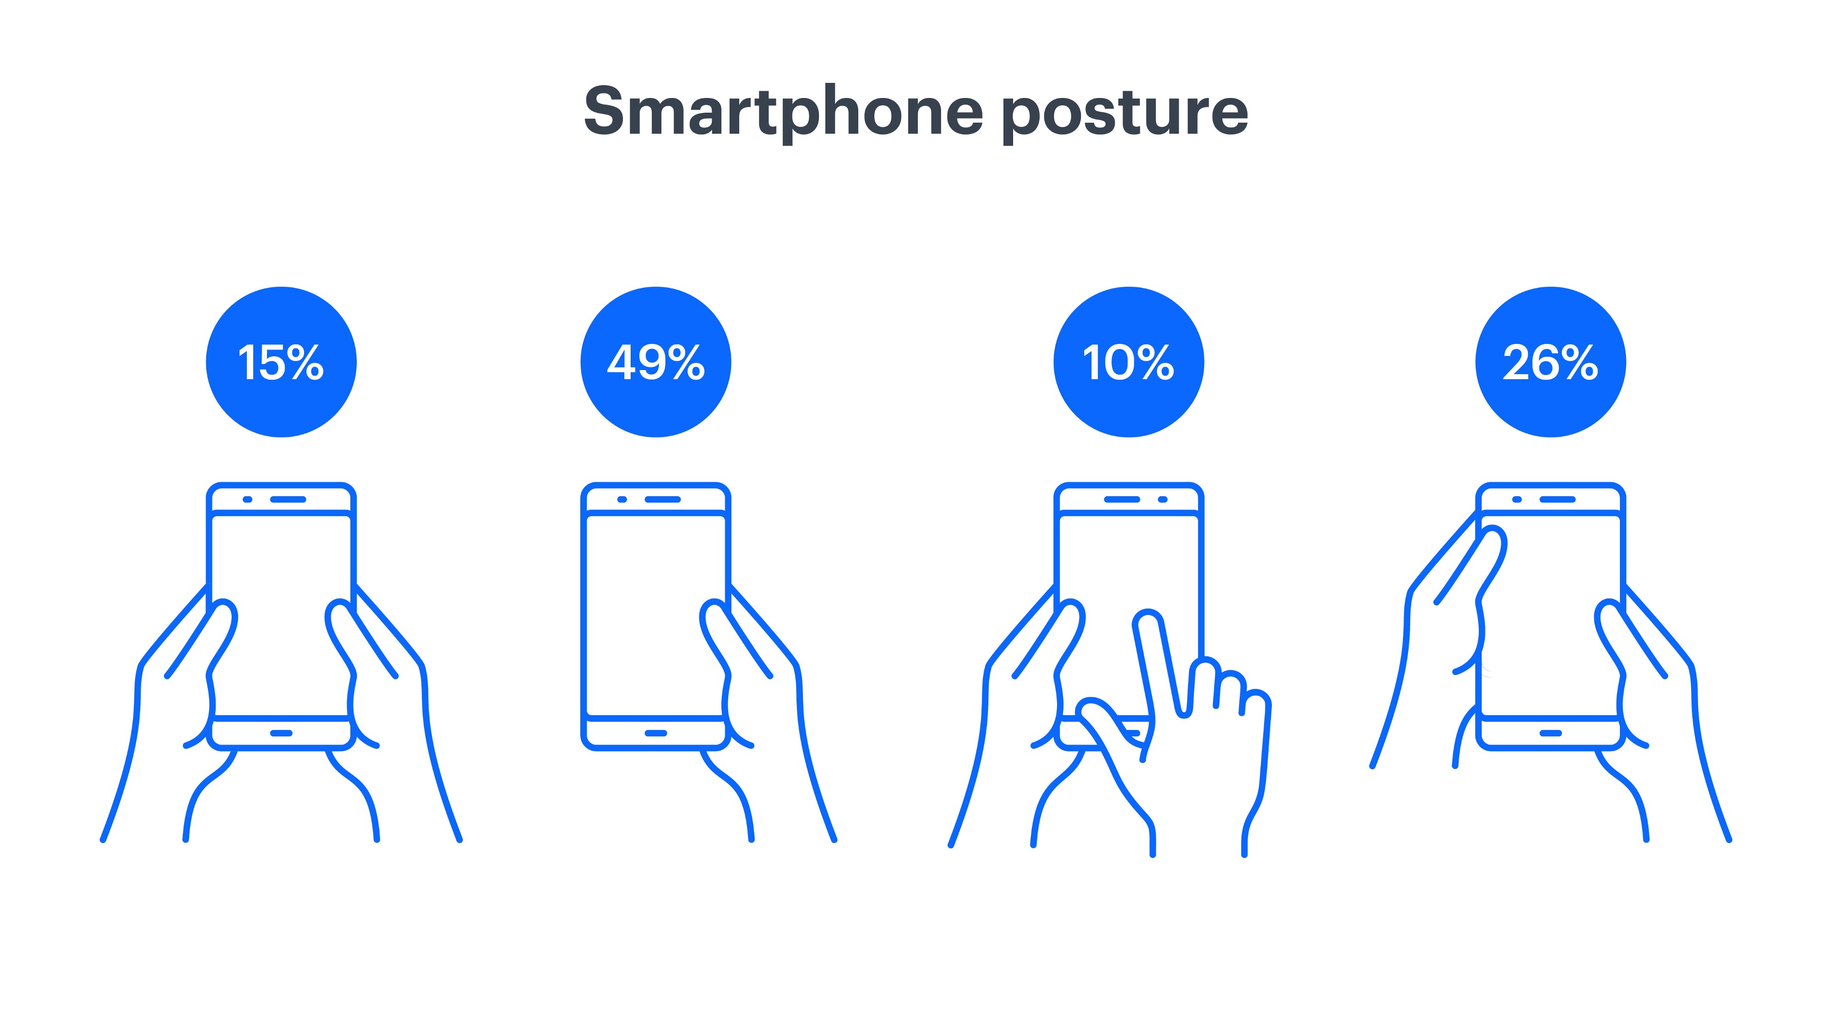

Slide 75
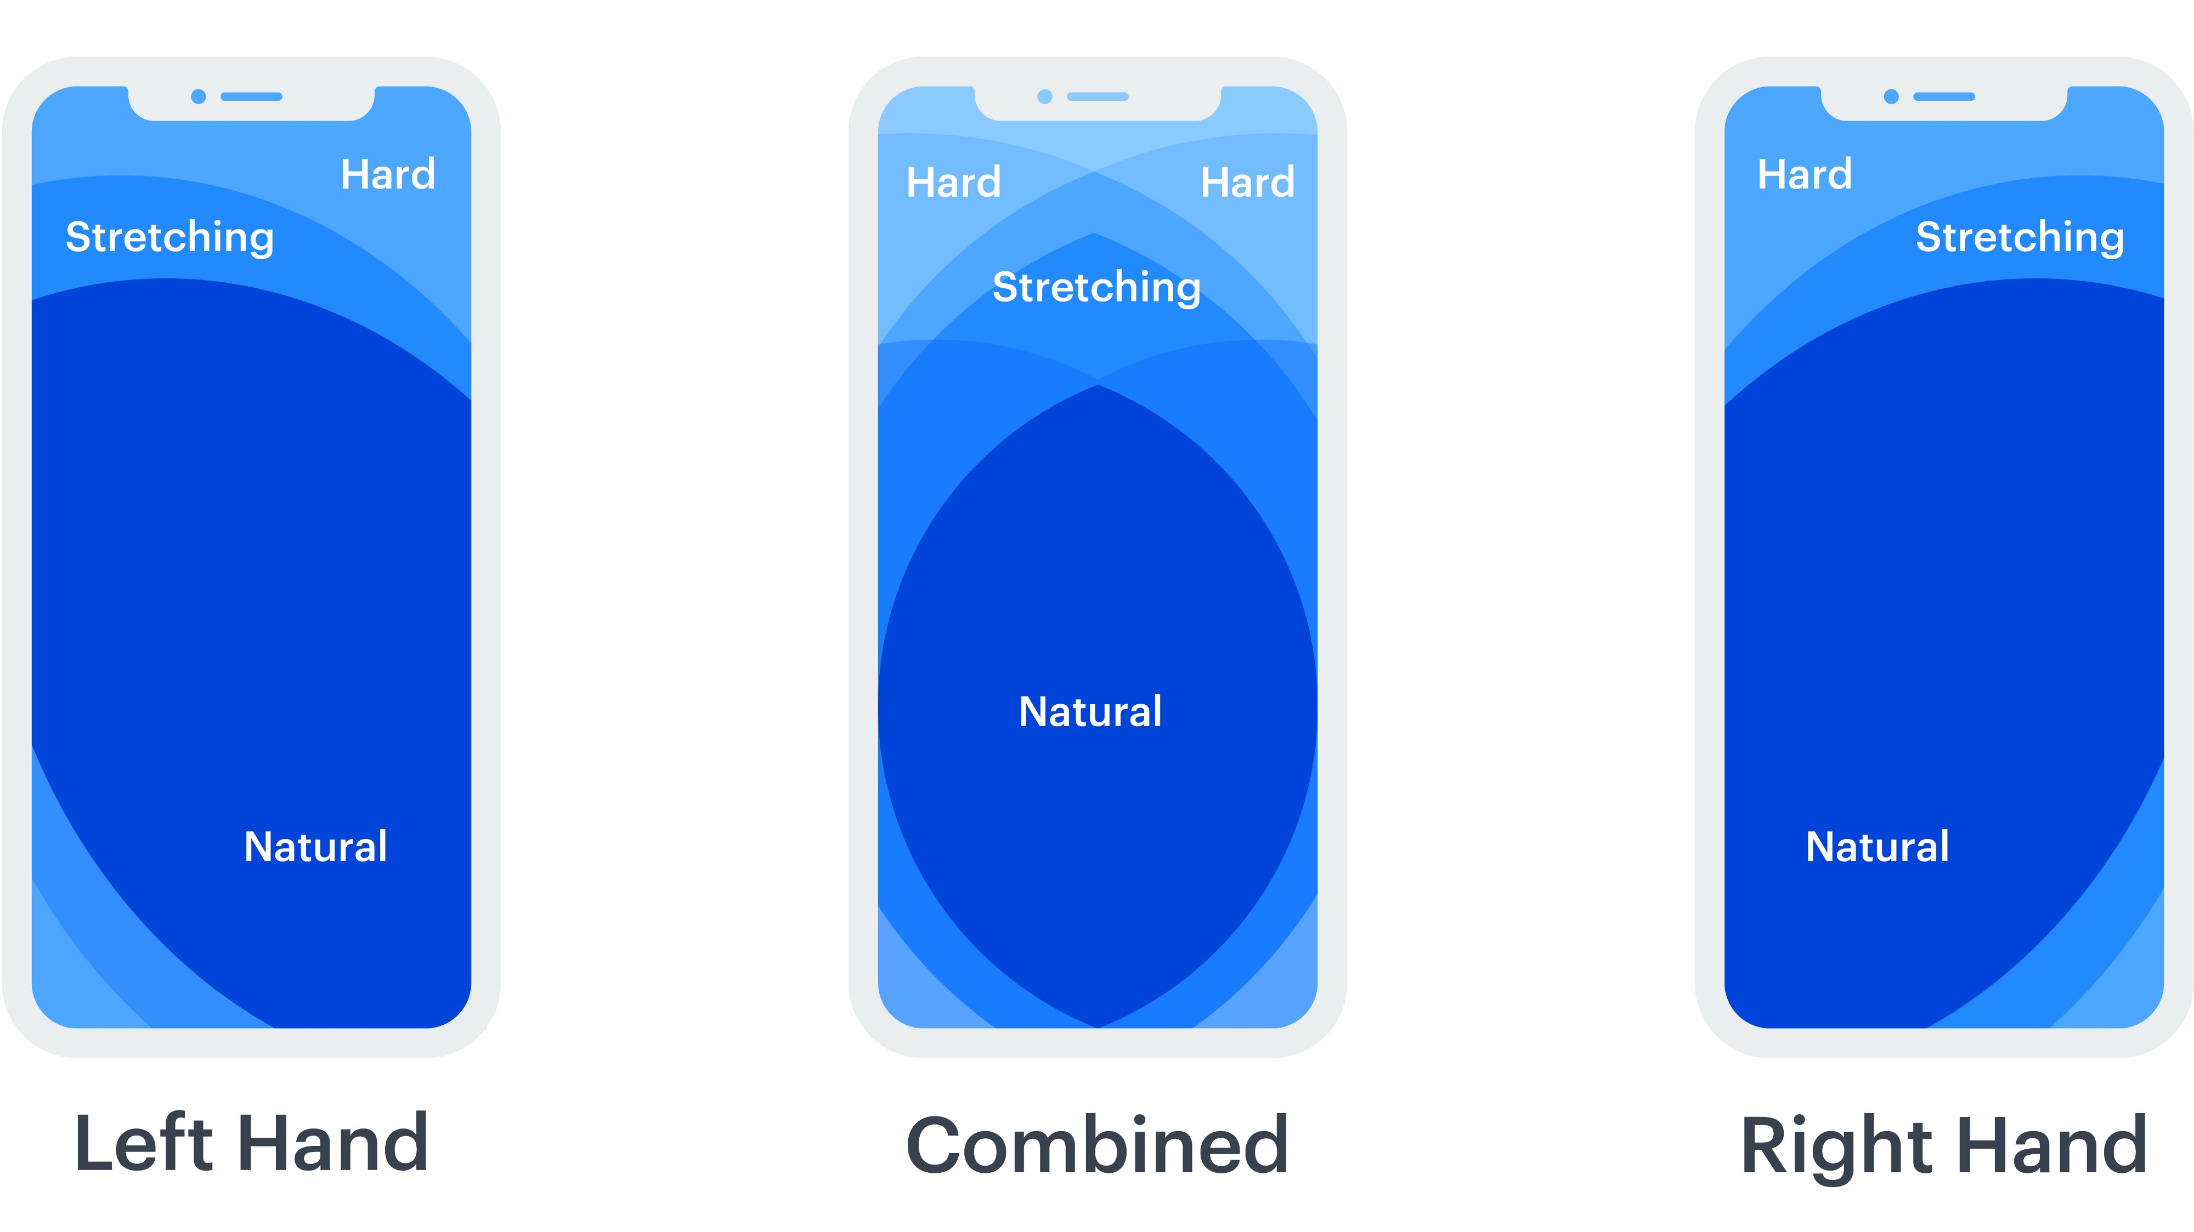

Slide 76
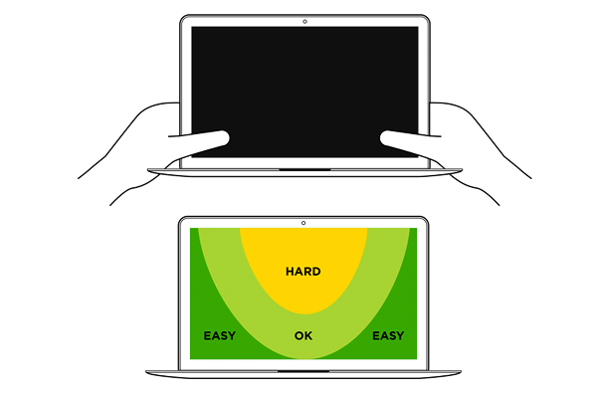

Slide 77
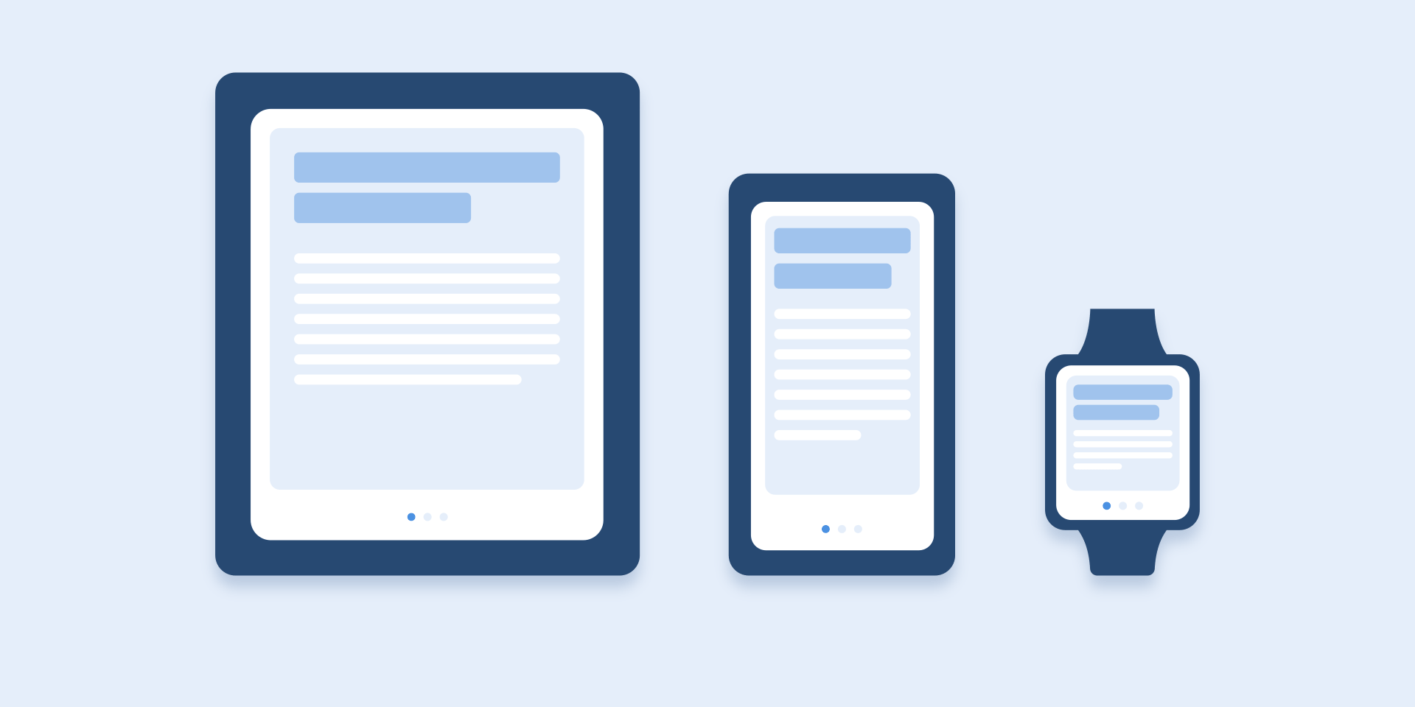
According to Material Design Guidelines, you should limit the animation duration to 200–300 ms.

Slide 78
The menu view depends on the size of the screen.

Slide 79
Power of Color
You can use color to visually separate other types of content.

Slide 80
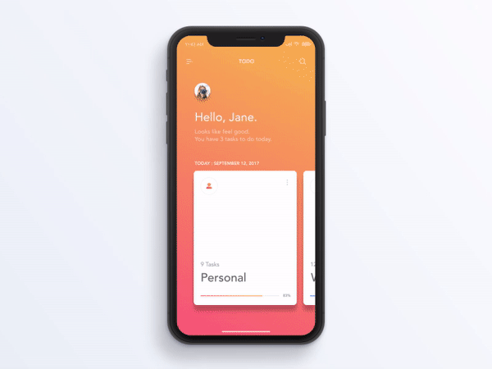

Slide 81
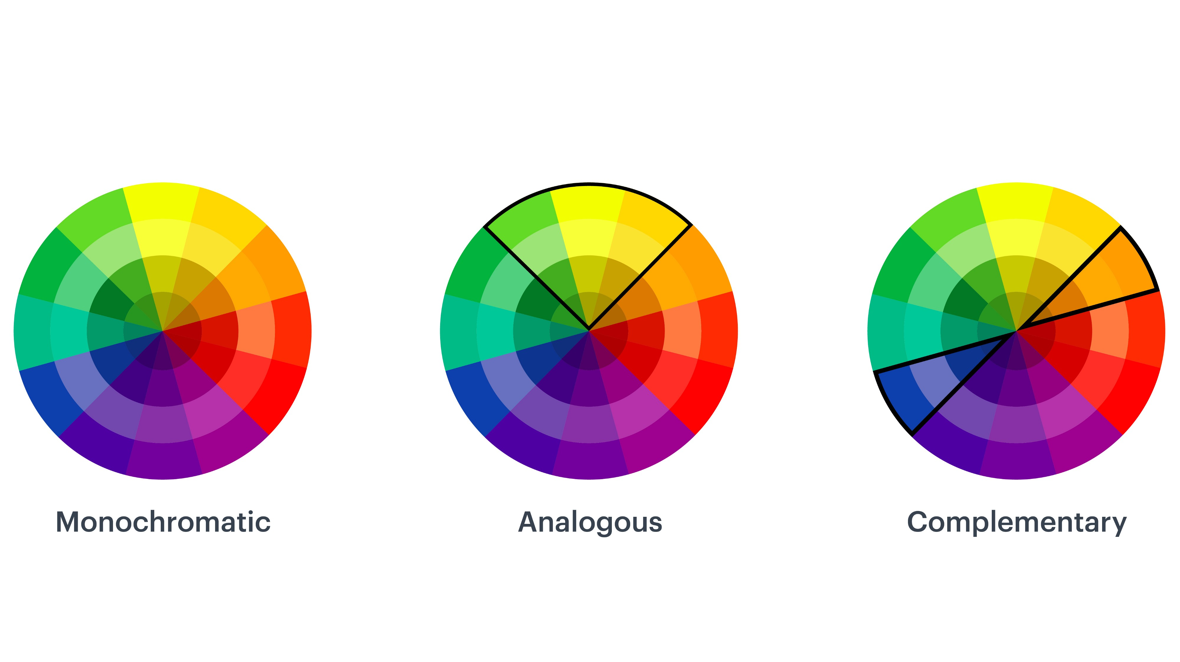

Slide 82
https://coolors.co/app

Slide 83
What is usability test?

Slide 84
Usability test
Observe what the users do, where they succeed, and where they have difficulties with the user interface.

Slide 85
Testing one user early in the project is better than testing 50 near the end. — Steve Krug

Slide 86
Usability test
5 users
Rather than run a big, expensive study, it's a better use of resources to run many small tests and revise the design between each one.

Slide 87
Focus Group
You must closely observe individual users as they perform tasks with the user interface. Listening to what people say is misleading: you have to watch what they actually do.

Slide 88
What is Heuristic Evaluation?

Slide 89
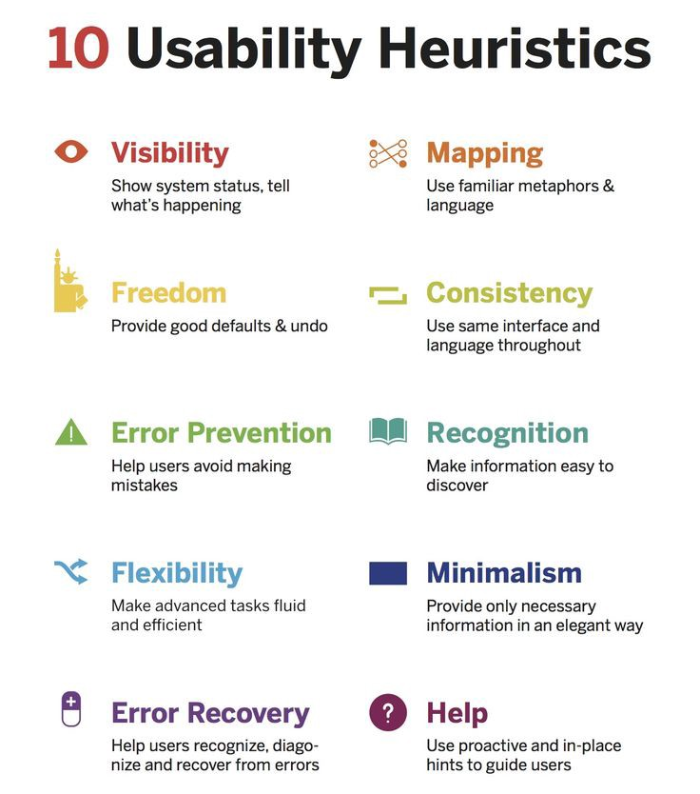

Slide 90
Heuristic Evaluation
Define the scope
Know the business requirements and the users
Decide on which reporting tools and heuristics to use
Evaluate the experience and identify usability issues
Analyze, aggregate, and present the results

Slide 91
Severity Ratings
Frequency: Is it common or rare?
Impact: Will it be easy or difficult for the users to overcome?
Persistence: Is it a one-time problem that users can overcome once they know about it or will users repeatedly be bothered by the problem?

Slide 92
Severity Ratings
0 = I don't agree that this is a usability problem at all
1 = Cosmetic problem only: need not be fixed unless extra time is available on project
2 = Minor usability problem: fixing this should be given low priority
3 = Major usability problem: important to fix, so should be given high priority
4 = Usability catastrophe: imperative to fix this before product can be released

Slide 93
https://www.nngroup.com/articles/ten-usability-heuristics/

Slide 94
What is Lo-Fi and Hi-Fi Prototypes?

Slide 95
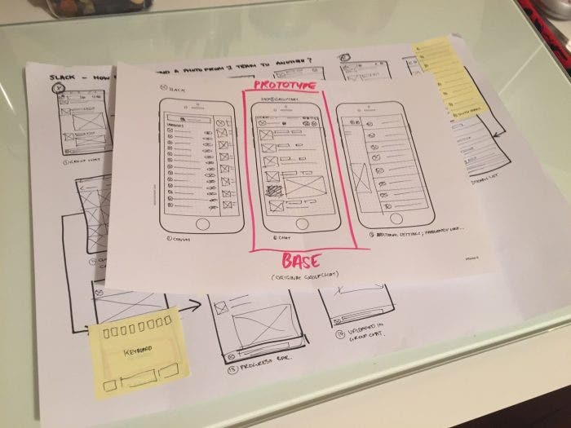

Slide 96
Low-Fidelity Prototype
Paper prototyping
Clickable wireframes

Slide 97
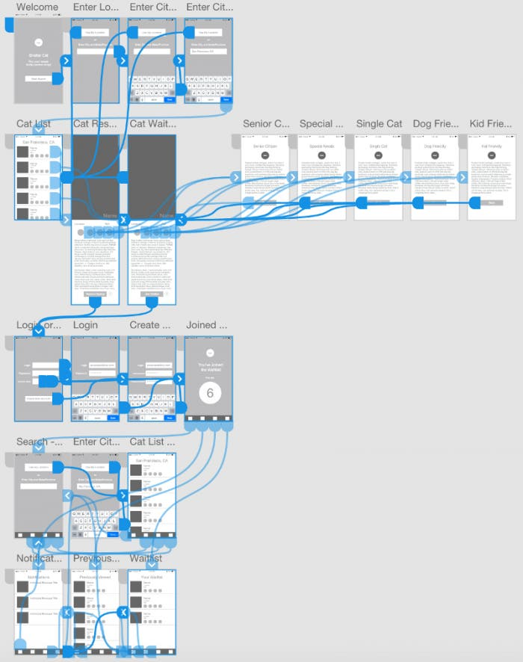

Slide 98
High-Fidelity Prototype
Digital Prototypes
Coded Prototypes

Slide 99
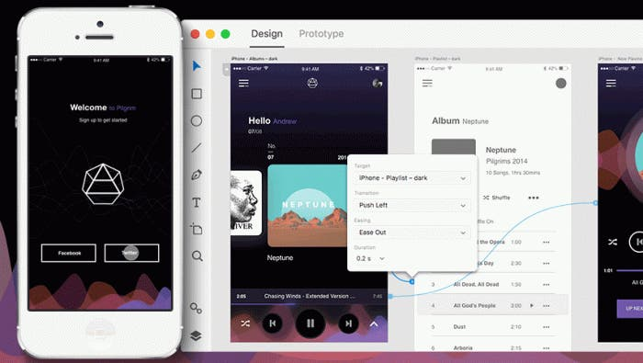

Slide 100
Adobe xd
https://developer.apple.com/design/resources/
https://material.io/resources
https://docs.microsoft.com/en-us/windows/uwp/design/downloads/
https://github.com/boraunal/FontAwesome-AdobeExperience-Design-XD

Slide 101
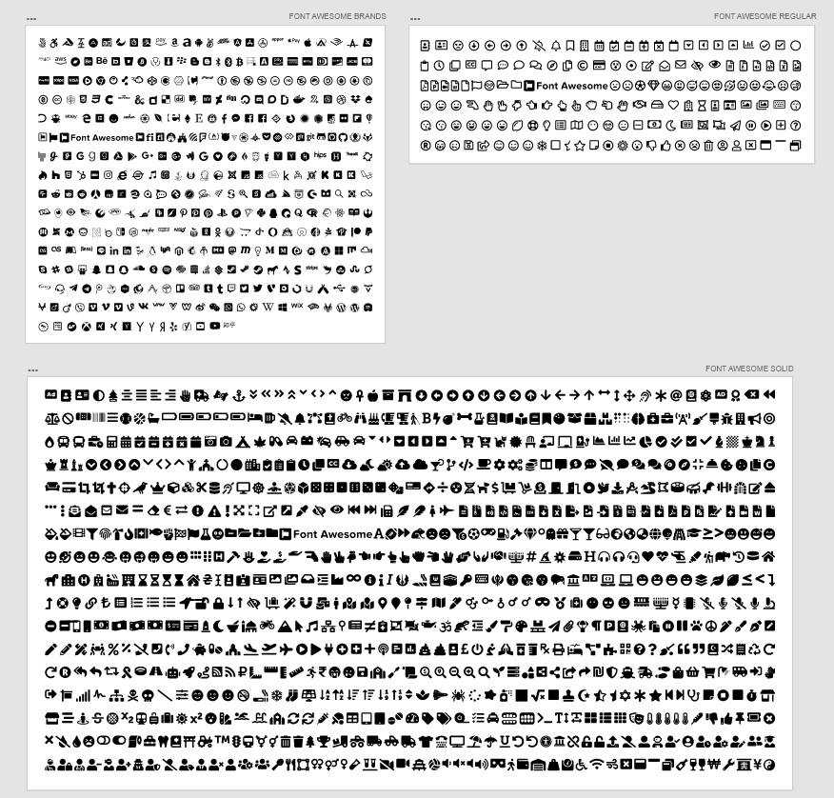

Slide 102
Mental Models in UX Design

Slide 103
Users will transfer expectations they have built around one familiar product to another that appears similar.

Slide 104
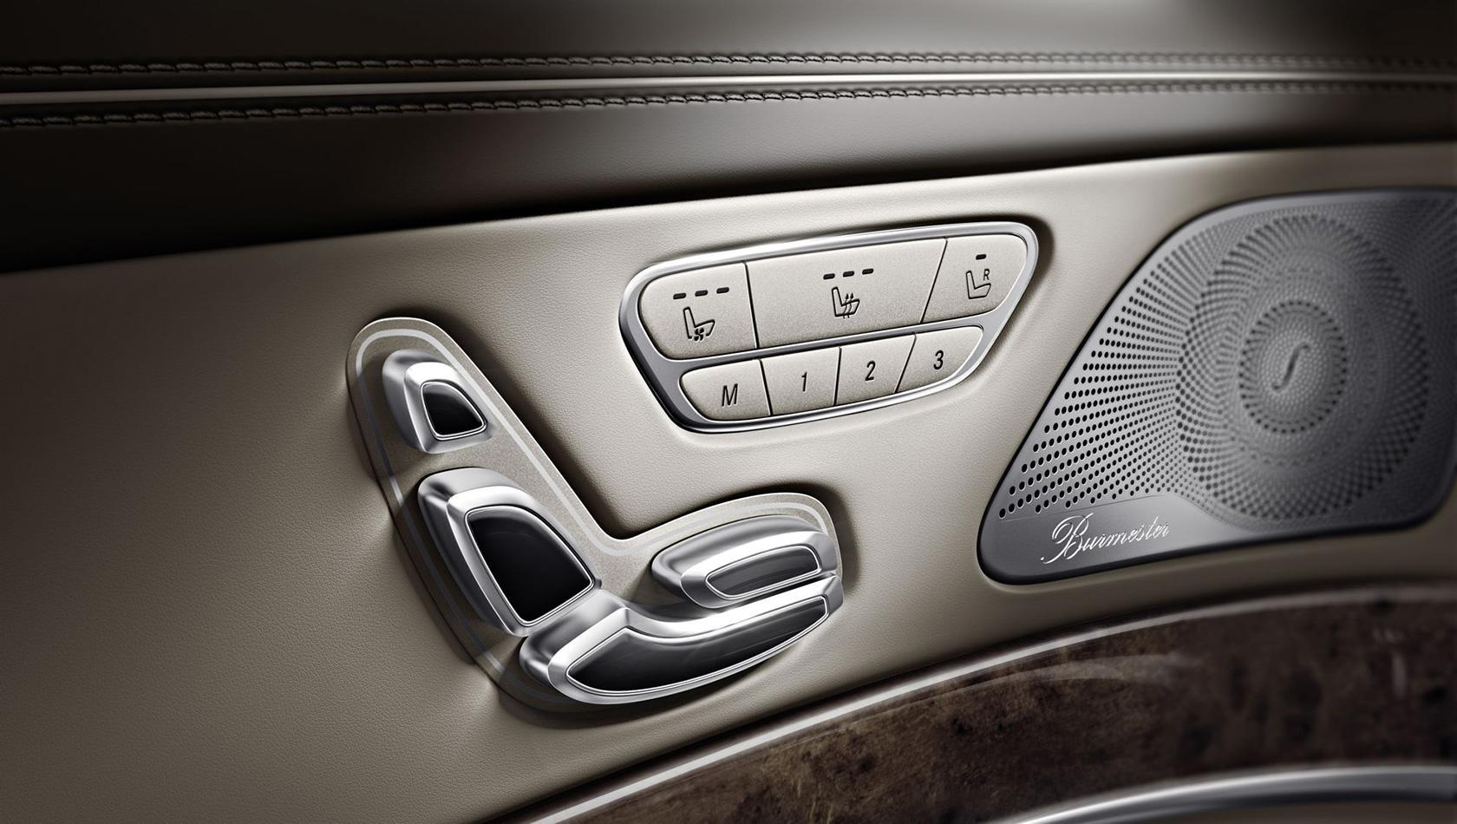

Slide 105
Register Continue

Slide 106
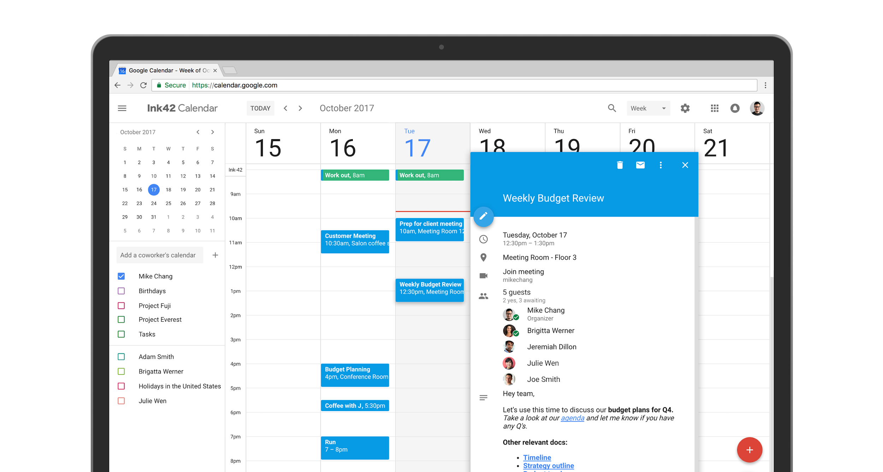
By warning and allowing them to opt in over several months, Google empowered its users to decide when to change their mental models of how the product should work.

Slide 107
Facebook introduced the interaction pattern of “Likes,” which were then copied by LinkedIn and Instagram.

Slide 108
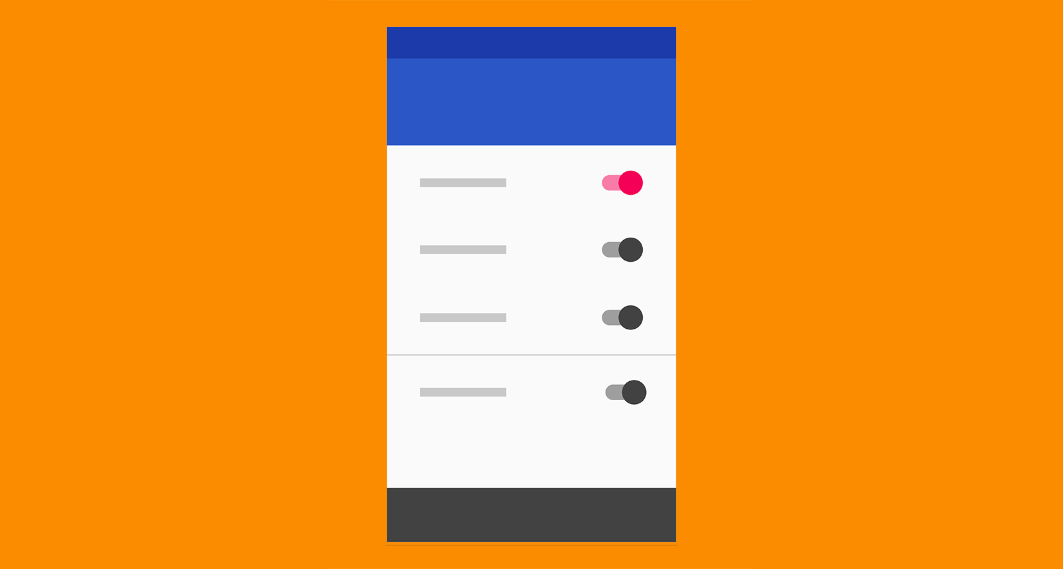
Google’s Material Design system uses very flat visual design and iconography but leverages common UI patterns based on physical metaphors to ensure optimal usability.

Slide 109
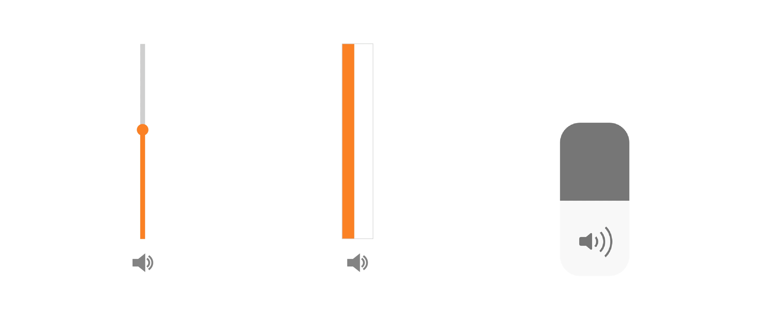

Slide 110
Don Norman’s Principles of Interaction Design

Slide 111
Visibility
Visibility is the basic principle that the more visible an element is, the more likely users will know about them and how to use them.

Slide 112
Hamburger Menu Tab-bar Menu

Slide 113
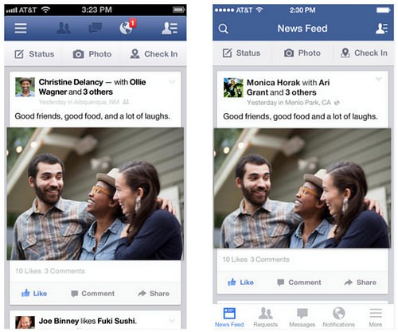

Slide 114
Feedback
Never leave the user guessing about what action they have taken and the consequence of doing so.
https://www.youtube.com/watch?v=Q8TXgCzxEnw

Slide 115
Constraints
Limiting the range of interaction possibilities for the user to simplify the interface and guide the user to the appropriate next action.

Slide 116
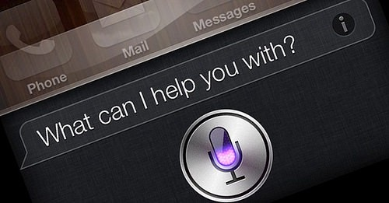

Slide 117
Mapping
Mapping is about having a clear relationship between controls and the effect they have on the world.

Slide 118
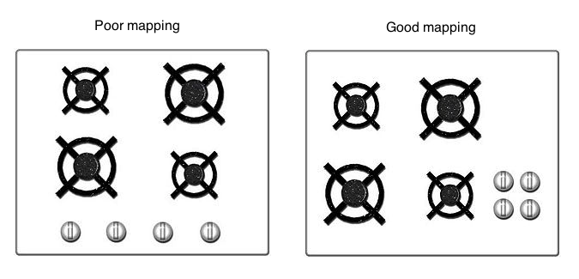


Slide 119
Affordance
Affordance refers to an attribute of an object that allows people to know how to use it.

Slide 120


Slide 121
Mobile Apps Typography

Slide 122
Minimum Font Size
Apple in its Human Interface Guidelines recommends setting the minimum size for Body text to be 17pt.
San Francisco / New York
Google in Material Design guidelines recommends setting the minimum size for Body text to be 16sp (equal to 16pt in iOs)
Roboto

Slide 123
Headline Font Size
Choose a headline size both contrasting with the body text and fitting on average 2–3 lines.

Slide 124
System Fonts
Use a system font for the body text and various controls and a non-default font for headings.

Slide 125
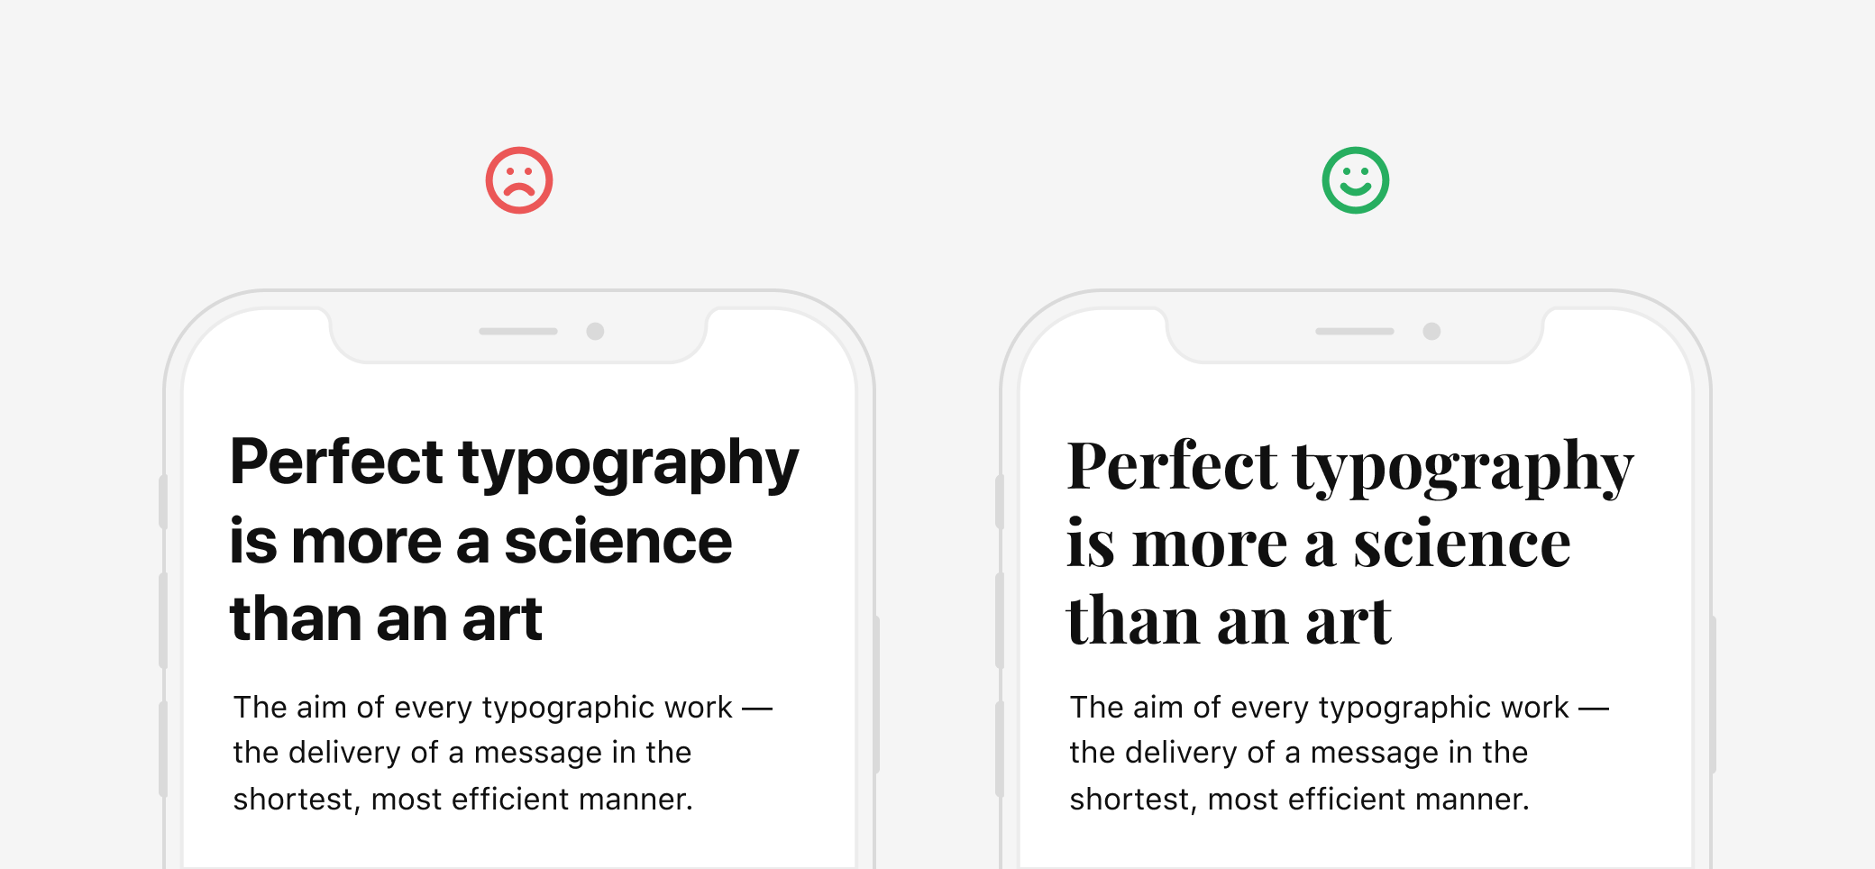

Slide 126
Whitespace and margins
Compose the layout so that part of the content was above the fold, thereby showing the user that there is more content and encouraging them to scroll.

Slide 127
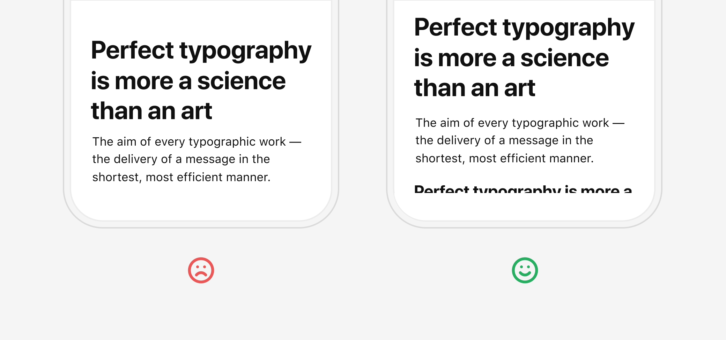

Slide 128
Color Usage in UI Design

Slide 129
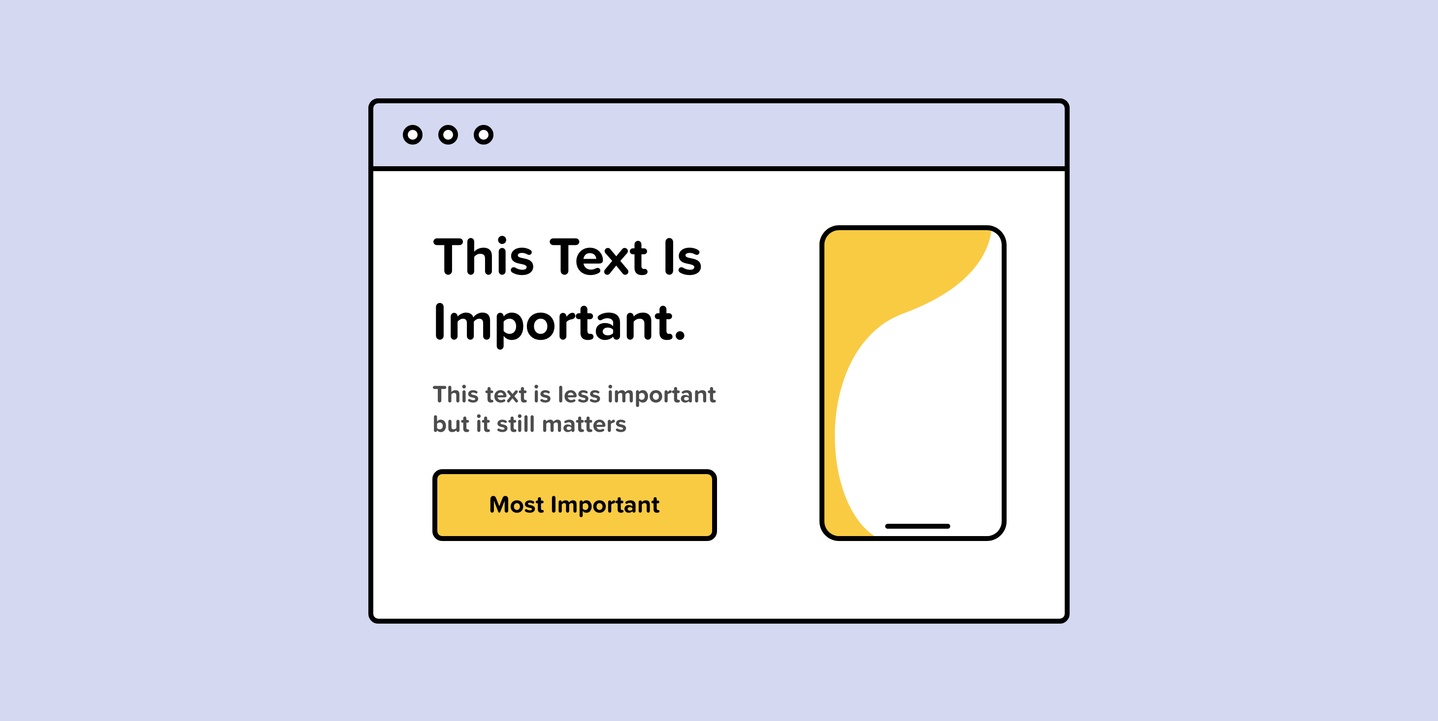

Slide 130
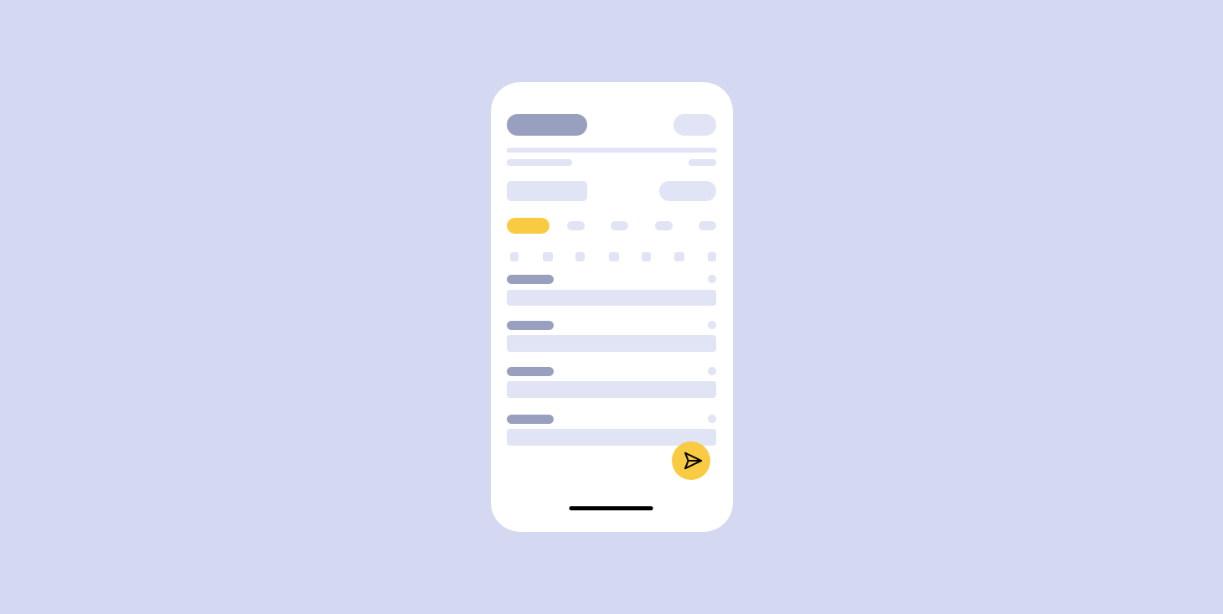

Slide 131
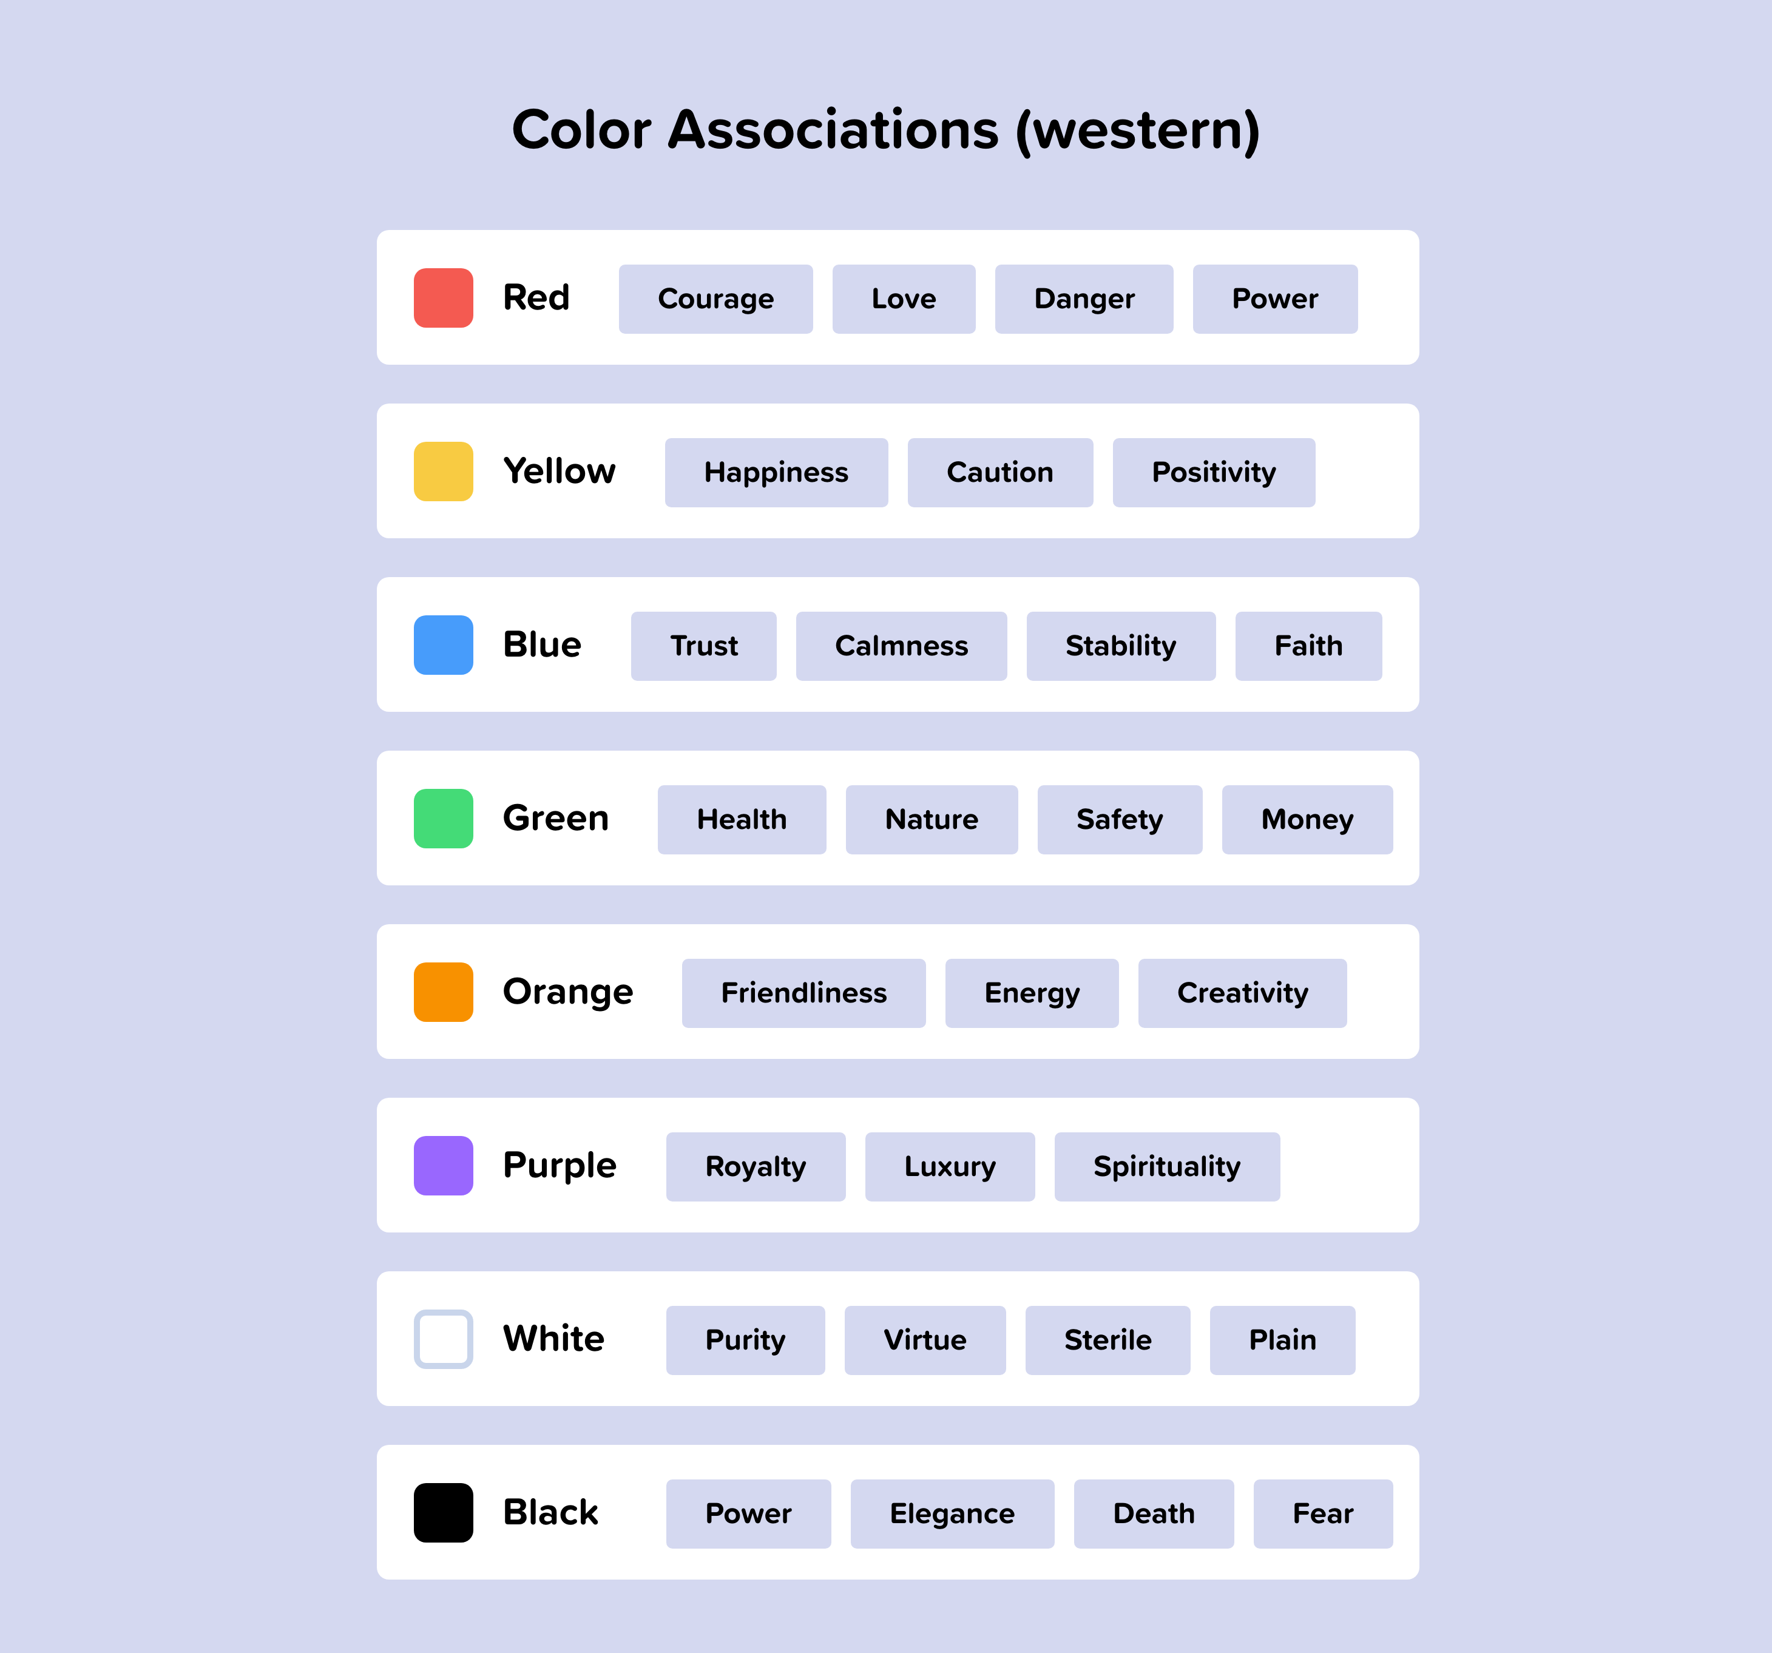

Slide 132
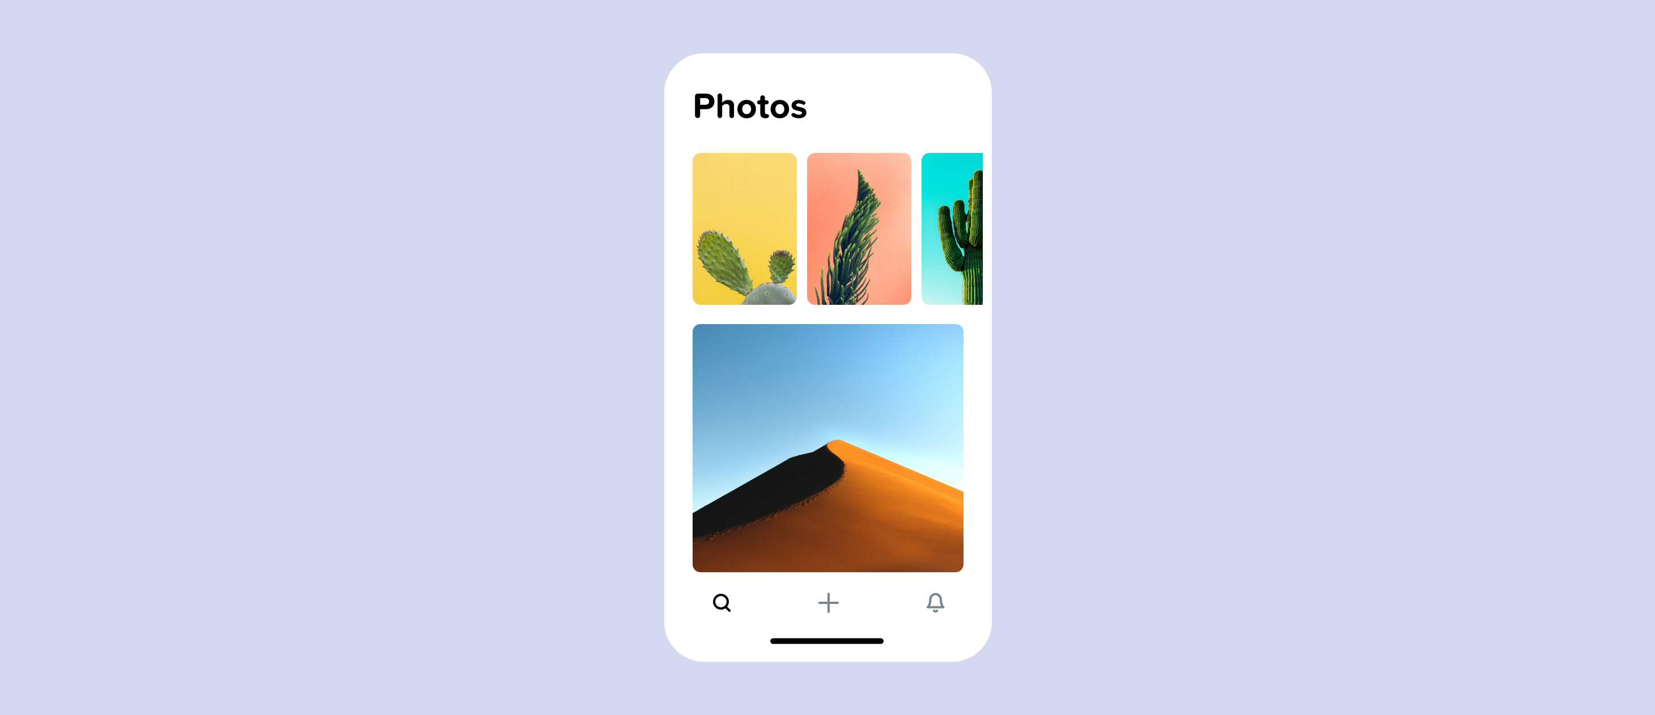

Slide 133
Limit Color
In many apps that have a lot of colorful posts and unpredictable content like Instagram or Twitter, their interface tends to be pretty plain.

Slide 134
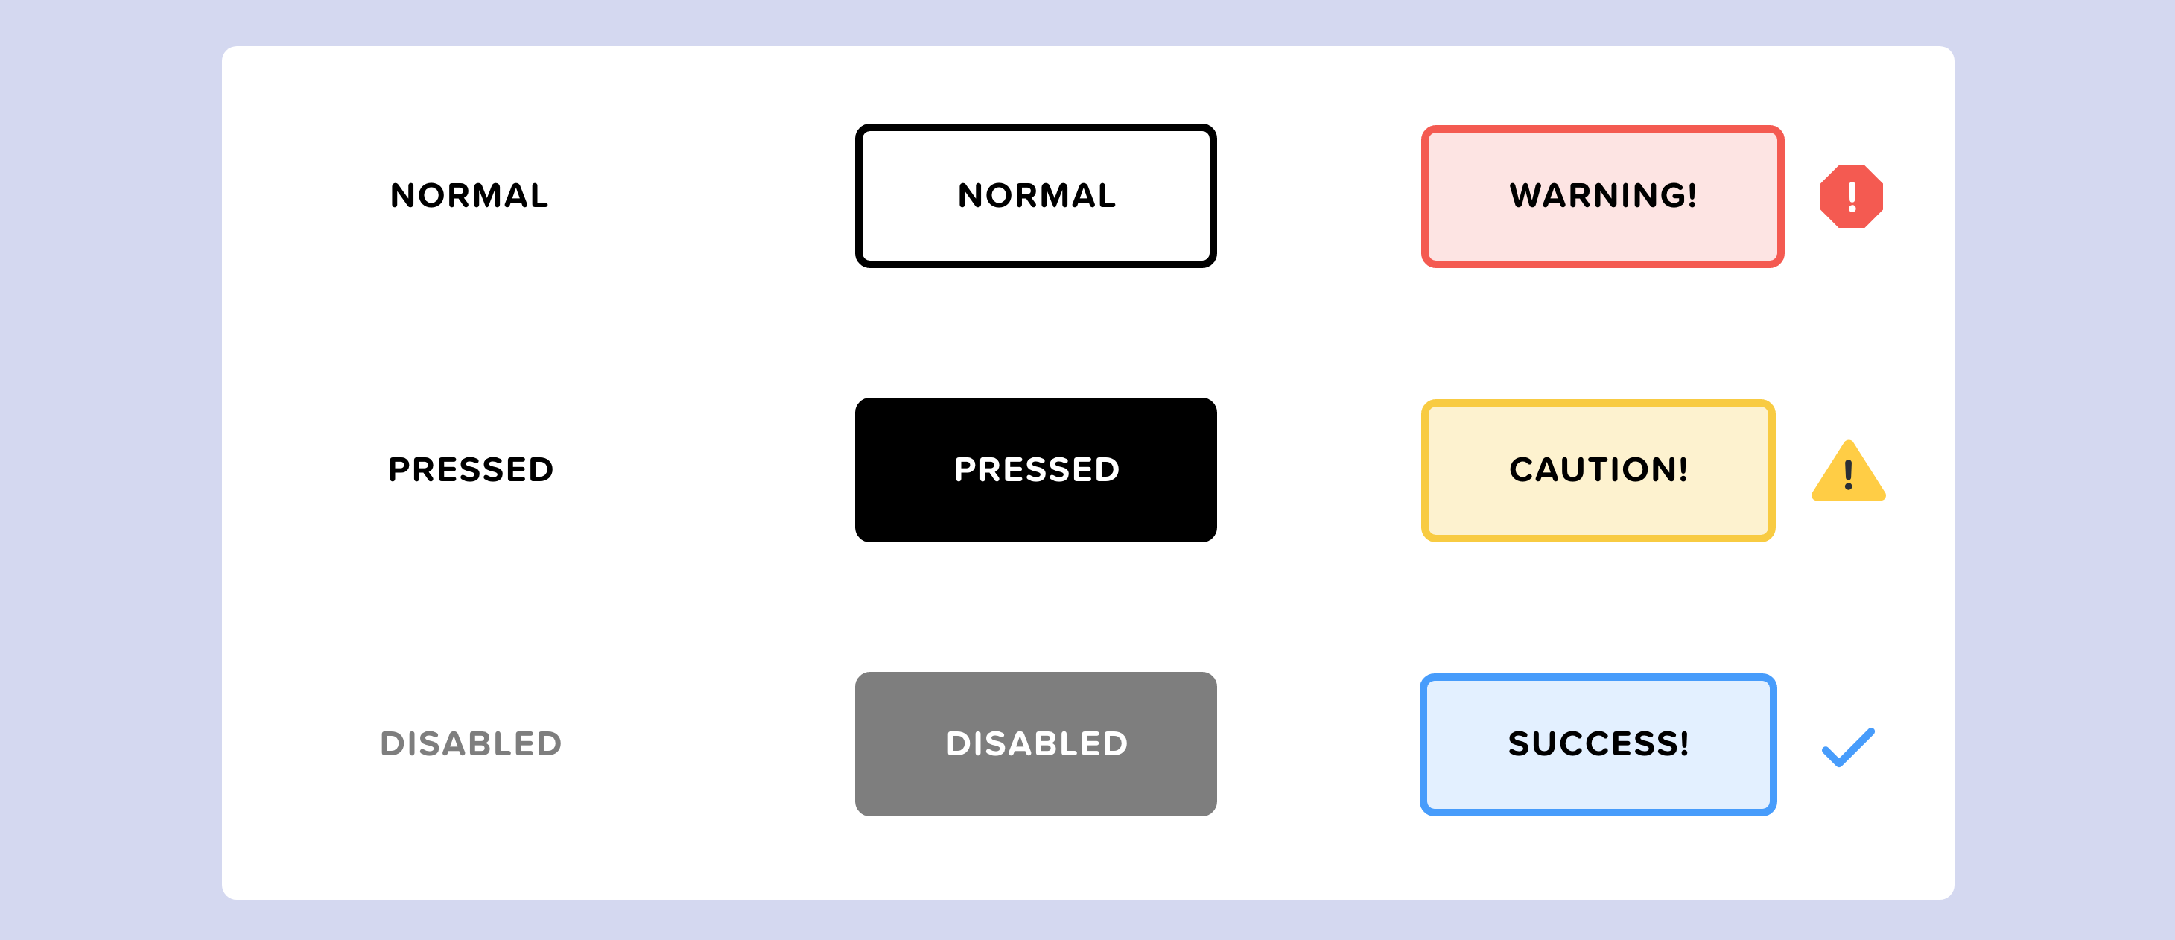

Slide 135
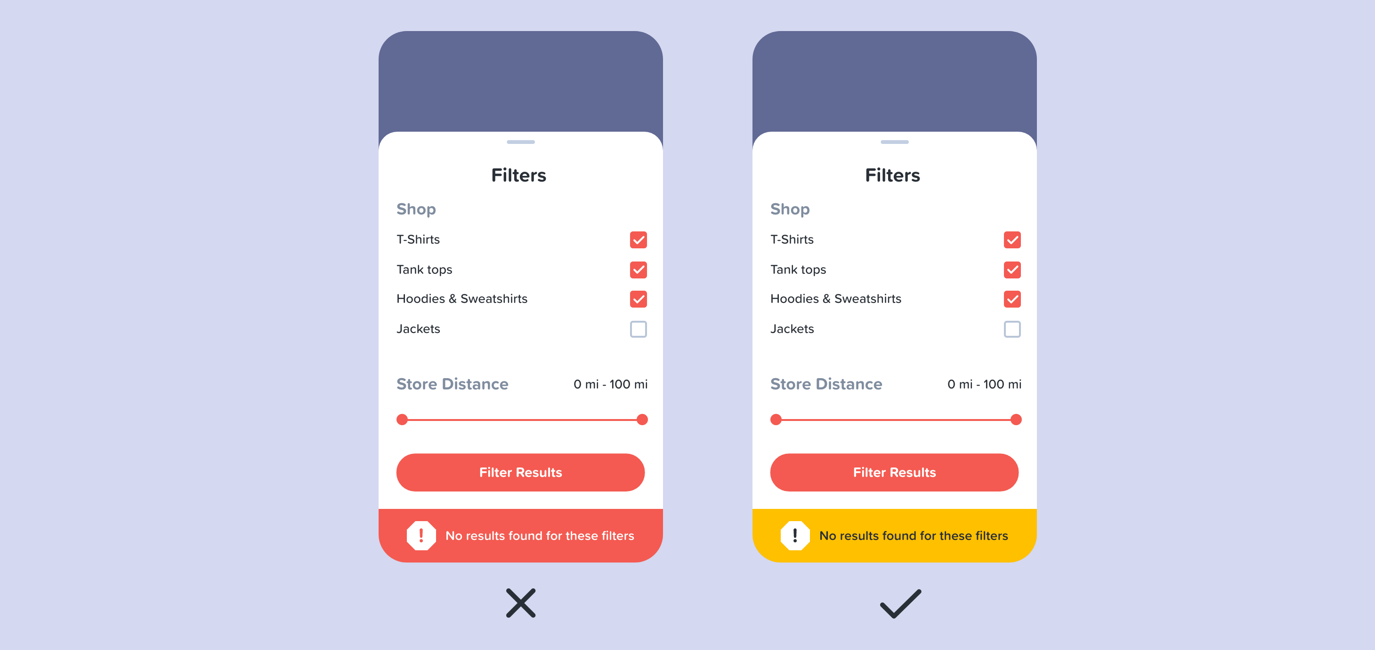

Slide 136
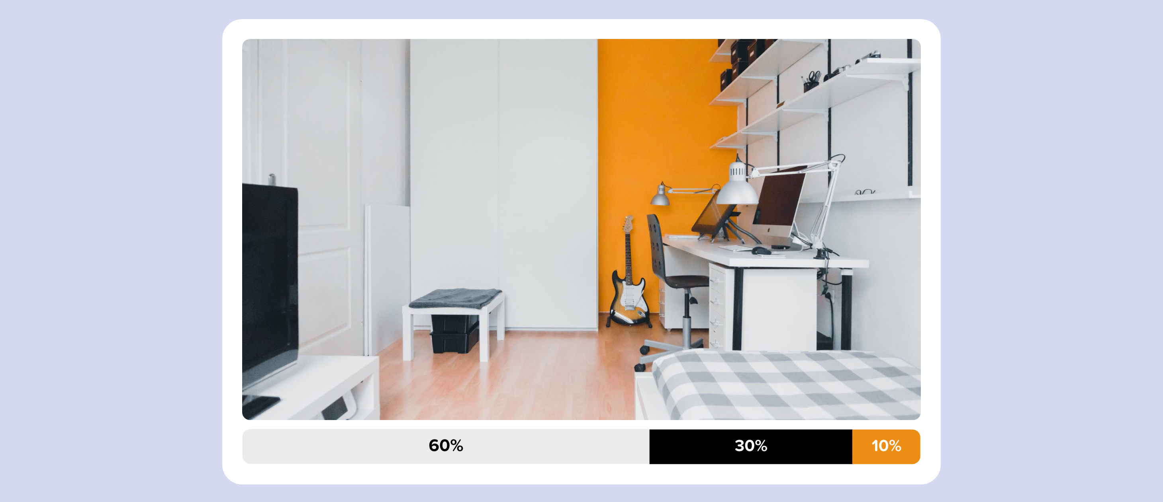
60% is your dominant color, 30% is a secondary color, and 10% is for accent color.

Slide 137
4.5% of the global population experience color blindness (that’s 1 in 12 men and 1 in 200 women), 4% suffer from low vision (1 in 30 people), and 0.6% are blind (1 in 188 people).

Slide 138
Don’t use color alone to convey meaning!

Slide 139


Slide 140


